Slide 1

The cases used here do not necessarily represent the views and guidelines of the AHA/ASA.

Slide 2

CASE ONE
PFO / RARE DISORDER
A 50-year-old man with “elephantiasis” and headache
Authors: Shadi Yaghi, MD; Tomoko Kitago, MD; Mitchell S.V. Elkind, MD, MS

Slide 3

CASE REPORT
CASE ONE
A 50-year-old man with a medical history of “elephantiasis” of the legs, status post left above the knee amputation with prosthetic limb, and hypothyroidism presented with 1 week of headache and nausea. The headache was continuous, with gradual worsening over the 7 days prior to admission, and he had minimal relief with ibuprofen. On the second day, he developed nausea. He denied any history of headaches, blurred or double vision, numbness, weakness, tingling, loss of balance, vertigo, chest pain, palpitations, or shortness of breath. In the emergency room, he was afebrile with a heart rate of 78 beats per minute and regular, and a blood pressure of 132/78 mm Hg. General physical examination revealed right leg hypertrophy with hyperpigmentation, and edema more prominent distally (tree-barking) (figure 1). A comprehensive neurologic examination had normal results. Basic laboratory tests including complete blood count, basic metabolic panel, and thyroid tests were within normal limits. Head CT showed a hypodensity in the left cerebellar hemisphere (figure 1).

Slide 4
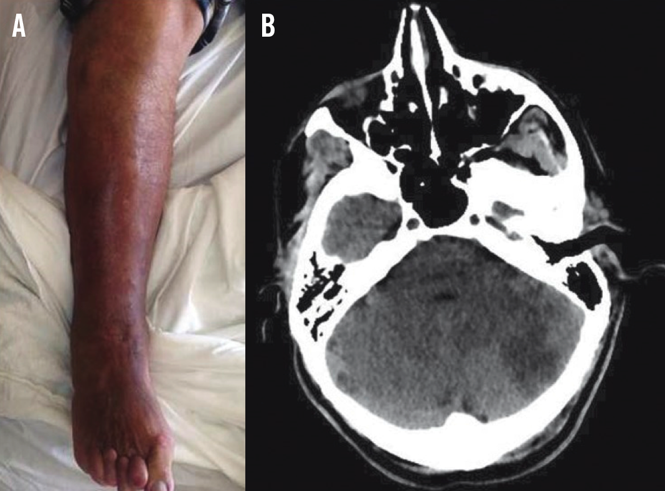
FIGURE 1
CASE ONE
A: Right leg hypertrophy with hyperpigmentation and tree-barking.
B: Noncontrast brain CT shows a hypodensity in left cerebellum.

Slide 5
CASE REPORT CONTINUED
CASE ONE
The patient has a subacute headache with a CT scan showing a hypodensity in the left cerebellar hemisphere. The most likely etiology of the patient's findings is a cerebellar stroke, which typically presents acutely and is more likely to be associated with headache at onset than strokes in other locations.¹ Other possible causes of cerebellar hypodensity on CT scan include an inflammatory cerebellitis or a cerebellar tumor. The normal neurologic examination does not exclude a vascular etiology since the absence of cerebellar findings on examination is not uncommon in patients with cerebellar stroke.² The patient had a brain MRI that showed an acute left cerebellar infarction and another small acute infarct in the left corona radiata (figure 2). Magnetic resonance angiography head and neck were within normal limits.

Slide 6
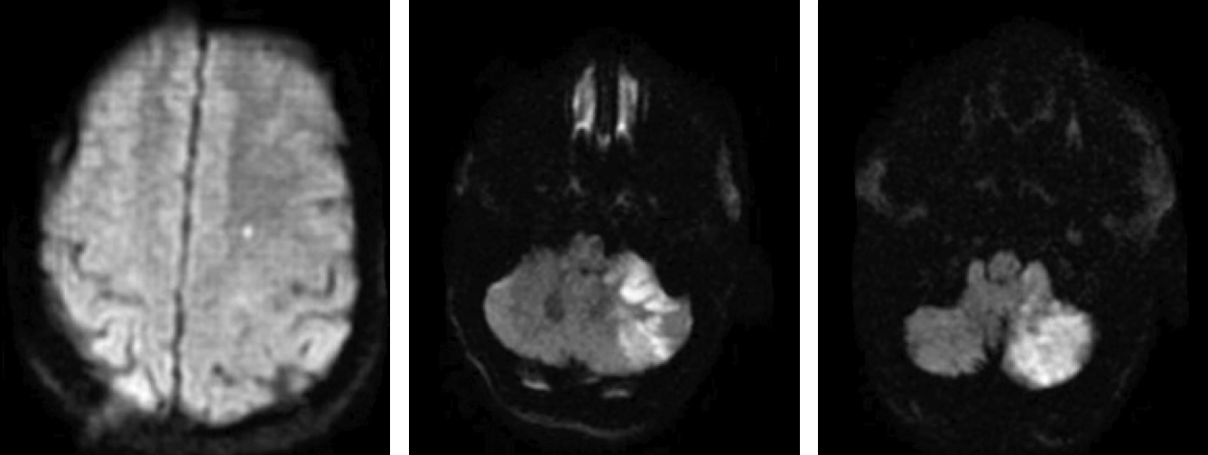
FIGURE 2
CASE ONE
MRI shows an acute left cerebellar infarct and a small infarct in the left corona radiata.

Slide 7
CASE REPORT CONTINUED
CASE ONE
The brain MRI showed infarcts in multiple vascular territories in both the posterior and anterior circulation (left posterior inferior cerebellar artery and left middle cerebral artery), which is a pattern typically considered suggestive of a proximal cardio-aortic embolic source, but that may also be seen with other etiologies such as vasculitis and multifocal atherosclerosis.³ Given that his vessel imaging did not demonstrate a stenosis, a cardiac source was highly suspected. Electrocardiogram and inpatient telemetry showed no evidence of atrial fibrillation. A transthoracic echocardiogram with agitated saline injection was performed, demonstrating right to left shunting consistent with a patent foramen ovale (PFO) without an associated atrial septal aneurysm, and this was confirmed by a transesophageal echocardiogram. Given the association between lower extremity and pelvic thrombi and cryptogenic stroke in patients with a PFO,⁴ the patient underwent lower extremity Doppler imaging and magnetic resonance venography (MRV) of the pelvis that showed no definite evidence of venous thrombi. The pelvic MRV, however, showed extensive pelvic varices (figure 3). The patient was started on aspirin that was later held due to hemorrhoidal bleeding requiring blood transfusion.

Slide 8
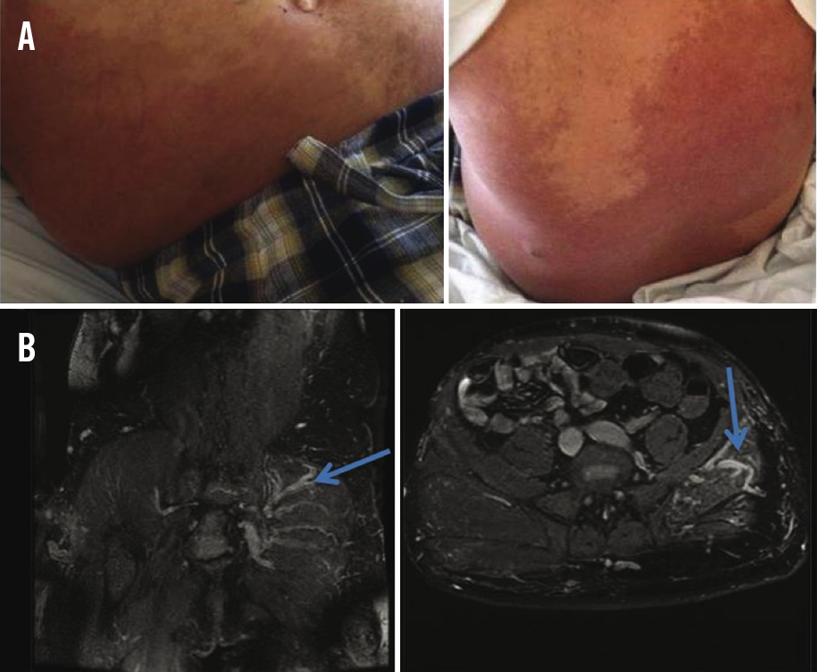
FIGURE 3
CASE ONE

Slide 9
REFERENCES
CASE ONE
Tentschert S, Wimmer R, Greisenegger S, Lang W, Lalouschek W. Headache at stroke onset in 2196 patients with ischemic stroke or transient ischemic attack. Stroke 2005;36:e1–e3. [PubMed]
Edlow JA, Newman-Toker DE, Savitz SI. Diagnosis and initial management of cerebellar infarction. Lancet Neurol 2008;7:951–964. [PubMed]
Yaghi S, Elkind MS. Cryptogenic stroke: a diagnostic challenge. Neurol Clin Pract 2014;4:386–393. [PMC free article] [PubMed]
Cramer SC, Rordorf G, Maki JH, et al. Increased pelvic vein thrombi in cryptogenic stroke: results of the paradoxical emboli from large veins in ischemic stroke (pelvis) study. Stroke 2004;35:46–50. [PubMed]
Kihiczak GG, Meine JG, Schwartz RA, Janniger CK. Klippel-Trenaunay syndrome: a multisystem disorder possibly resulting from a pathogenic gene for vascular and tissue overgrowth. Int J Dermatol 2006;45:883–890. [PubMed]
Douma RA, Oduber CE, Gerdes VE, et al. Chronic pulmonary embolism in Klippel-Trenaunay syndrome. J Am Acad Dermatol 2012;66:71–77. [PubMed]
Beume LA, Fuhrmann SC, Reinhard M, Harloff A. Coincidence of ischemic stroke and recurrent brain haemorrhage in a patient with Klippel-Trenaunay syndrome. J Clin Neurosci 2013;20:1454–1455. [PubMed]
Kim YW, Kim N, Hwang JM, Choung HK, Khwarg SI. Teaching NeuroImages: multiple giant intracranial aneurysms in Klippel-Trenaunay syndrome. Neurology 2013;81:e17–18. [PubMed]
Wilson CL, Song LM, Chua H, et al. Bleeding from cavernous angiomatosis of the rectum in Klippel-Trenaunay syndrome: report of three cases and literature review. Am J Gastroenterol 2001;96:2783–2788. [PubMed]
Ntaios G, Papavasileiou V, Makaritsis K, Michel P. PFO closure vs. medical therapy in cryptogenic stroke or transient ischemic attack: a systematic review and meta-analysis. Int J Cardiol 2013;169:101–105. [PubMed]

Slide 10

CASE TWO
OCCULT ATRIAL FIBRILLATION
An 87-year-old woman with left-sided numbness
Authors: Shadi Yaghi, MD; Mitchell S.V. Elkind, MD, MS

Slide 11
CASE REPORT
CASE TWO
An 87-year-old woman with a history of hypertension, hyperlipidemia, and peripheral vascular disease presented with acute left paresthesias. On evaluation, blood pressure was 152/77 mm Hg and heart rate 78 and regular. Physical examination had normal results. On neurologic examination, she had normal mental status, decreased sensation on the left face, and normal strength, tone, and reflexes. Cerebellar examination and gait were normal. There was reduced light touch and pinprick sensation of the left arm and leg, with no extinction. Complete blood count and comprehensive metabolic panel were within normal limits, and ECG showed normal sinus rhythm. Head CT scan was unremarkable. She was prescribed aspirin and admitted for evaluation. Symptoms lasted 48 hours. Brain MRI showed no acute infarction. Magnetic resonance angiography showed normal intracranial vessels and mild bilateral internal carotid disease. Echocardiography showed an ejection fraction of 55%–60% and no structural abnormalities, though the left atrium was not visualized. On telemetry, she had 2 self-limited episodes of asymptomatic paroxysmal supraventricular tachycardia. She started a low dose β-blocker. Given the acuity of symptoms, her focal neurologic deficits, and the fact that her deficits lasted over 24 hours, a clinical stroke was diagnosed.¹ The CT scan did not reveal hemorrhage. Although her brain MRI did not show evidence of infarction, this did not eliminate the diagnosis of stroke as a negative diffusion-weighted imaging (DWI) MRI sequence can be seen in up to 20% of patients with ischemic stroke.2 Absence of DWI signal abnormality is more common in patients with small subcortical strokes.2 In some instances, repeat MRI detects infarcts even when initial MRI scan is negative.²

Slide 12
CASE REPORT CONTINUED
CASE TWO
The mechanism of stroke remained uncertain. Vessel imaging did not show significant large artery intracranial atherosclerotic disease, no cardioembolic etiology was identified on transthoracic echocardiography, and no atrial fibrillation (AF) was detected on inpatient telemetry. The patient's presentation with a pure sensory syndrome was suggestive of a clinical lacunar stroke affecting the right lateral thalamus, despite her negative diffusion imaging. Although lacunar strokes are classically attributed to intrinsic small vessel disease, up to 25% are due to other mechanisms of stroke, including cardioembolism.³ Noninvasive testing in patients with cryptogenic stroke via transcranial Doppler with agitated saline may also be useful in detecting PFO.
Cryptogenic, or unexplained, stroke comprises about 30%–40% of ischemic strokes.⁴ Potential stroke mechanisms in cryptogenic stroke include paroxysmal AF, substenotic atherosclerotic plaque, and other low-risk cardiac sources such as patent foramen ovale (PFO) and aortic arch atheroma. Paroxysmal AF is one of the most common causes identified in patients with cryptogenic stroke.⁴ Admission ECG or 24-hour telemetry is useful in the diagnosis of persistent or paroxysmal frequent AF, with a yield up to 7% in ischemic stroke patients.⁴ These tests, however, are not very useful in detecting infrequent paroxysmal episodes of AF. Recent evidence from the 30-day cardiac Event Monitor Belt for Recording Atrial Fibrillation after a Cerebral Ischemic Event (EMBRACE) study supports the superiority of mobile continuous outpatient telemetry (MCOT) over inpatient telemetry or 24-hour Holter monitoring in detecting AF in patients with cryptogenic stroke (16.1% vs 3.2% detection).⁵

Slide 13
CASE REPORT CONTINUED
CASE TWO
In addition, the Cryptogenic Stroke and Underlying Atrial Fibrillation (CRYSTAL AF) study randomized patients with cryptogenic stroke and negative transesophageal echocardiography to either an implantable loop recorder or standard of care. This study showed higher detection rates of paroxysmal AF with implantable loop recorders (detection rates of 8.9% vs 1.4%).⁶ Although outpatient cardiac monitoring is therefore more likely to detect AF than inpatient telemetry and ECG, the optimal duration and monitoring method remain unclear in the absence of trials comparing different methods and durations of outpatient monitoring. Atrial ectopy also predicts detection of AF with monitoring. In the EMBRACE study, for example, patients who had AF detected during 30 days of monitoring had significantly more atrial premature beats.⁷ Because of the absence of confirmed subcortical stroke on MRI, and the presence of atrial ectopy on telemetry, the patient underwent further cardiac monitoring after discharge. MCOT showed a single equivocal episode of paroxysmal supraventricular tachycardia, vs AF, lasting for less than 6 seconds (figure).

Slide 14
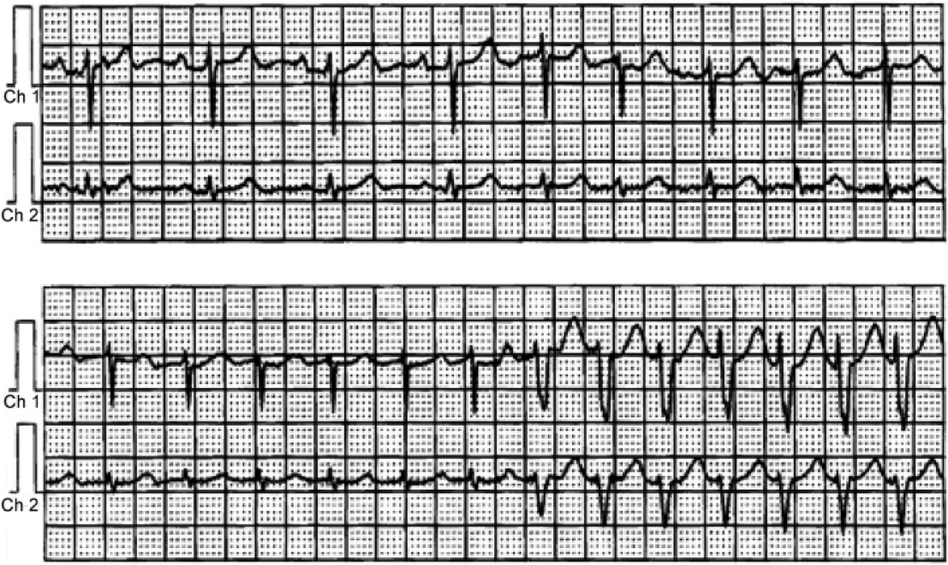
FIGURE 1
CASE TWO
Mobile continuous outpatient telemetry shows a 6-second episode of paroxysmal atrial fibrillation vs paroxysmal supraventricular tachycardia with aberrancy

Slide 15
CASE REPORT CONTINUED
CASE TWO
There was uncertainty about whether the patient had experienced paroxysmal AF (PAF) or paroxysmal supraventricular tachycardia (PSVT) with aberrancy, and the episode was very brief. Recent evidence suggests the possibility of an increased risk of stroke in patients with PSVT. In a study using administrative inpatient data, patients with PSVT had a higher risk of stroke in the absence of AF after adjusting for stroke risk factors (hazard ratio, 2.10; 95% confidence interval, 1.69–2.62).⁸ In the absence of trials of specific antithrombotic regimens among patients with PSVT, however, there is no evidence supporting the use of anticoagulants for stroke prevention in those patients. The benefit of chronic anticoagulation in patients with AF episodes lasting less than 30 seconds is also unclear. There is evidence to suggest, however, that episodes of AF lasting ≥5 minutes are associated with a 2-fold increase in risk of stroke or death.⁹ Given the uncertainty that the episode was AF and its brief duration, the patient was maintained on aspirin and another 3 weeks of MCOT was prescribed, during which she had clear episodes of AF. She had no contraindications to anticoagulation.

Slide 16
CASE REPORT CONTINUED
CASE TWO
The patient was diagnosed with PAF. The risk of ischemic stroke could now be calculated using well-accepted risk stratification schemes. The congestive heart failure, hypertension, age ≥75 years, diabetes, stroke (CHADS2) and congestive heart failure, hypertension, age ≥75 years, diabetes mellitus, stroke/TIA, vascular disease, age 65–74 years, sex category (CHA2DS2-VASc) scores predict the risk of stroke in patients with AF (table). For each point of the CHADS2 score, there is an approximate 2% increase in absolute risk of stroke or systemic thromboembolism. A limitation of the CHADS2 score is that it discriminates poorly among those at the lower end of the risk spectrum. The CHA2DS2-VASc score incorporates additional risk factors, including levels of age, sex, and other atherosclerotic and vascular diseases that increase stroke risk. Those with CHA2DS2-VASc scores of 0–1 appear to be at very low risk of stroke. In large cohorts analyzed thus far, the CHA2DS2-VASc score demonstrated better predictive value than the CHADS2 score. However, the predictive value of all scores remains limited, and these scores are based on analyses of prior cohorts of patients, and current risks may be lower due to advances in treatment and increasing use of other preventive medications, such as statins.

Slide 17
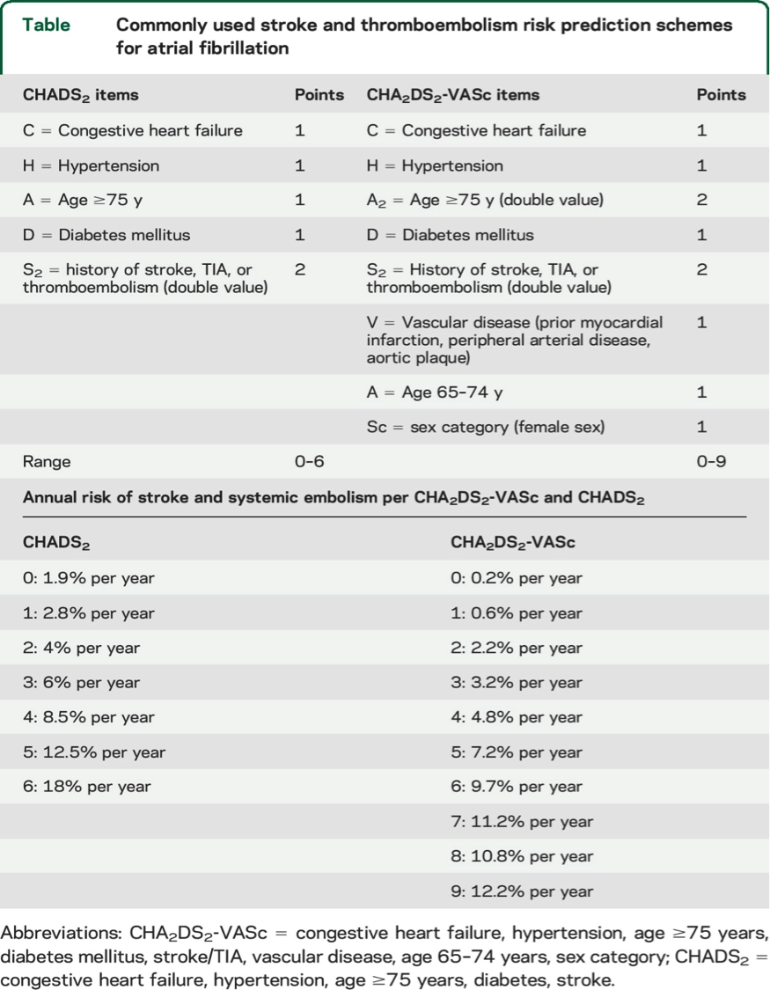
TABLE
CASE TWO

Slide 18
CASE REPORT CONTINUED
CASE TWO
The patient had a CHADS2 score of 4 (corresponding to annual stroke or systemic thromboembolism risk of 8.5%) and a CHA2DS2-VASc score of 7 (annual stroke or thromboembolism risk of 11.2%). Anticoagulation has been shown in randomized controlled trials to be superior to antiplatelet therapy in primary stroke prevention in patients with AF who are considered to be at high risk of stroke, i.e., those with CHADS2 score >1 or CHA2DS2-VASc score >1, and for secondary stroke prevention in patients with AF.
Recent evidence suggests that non-vitamin K oral anticoagulants (NOACs) are as effective as vitamin K antagonists (VKAs) such as warfarin in the prevention of stroke and systemic embolism in patients with AF with a lower risk of intracranial hemorrhage. As compared to warfarin, dabigatran was associated with reduced risk of ischemic stroke and systemic embolism as well as intracranial hemorrhage, but with a higher rate of gastrointestinal hemorrhage.¹⁰ Apixaban was similarly superior to warfarin in the prevention of stroke and systemic embolism with a lower risk of intracranial hemorrhage. Rivaroxaban had a similar efficacy in the prevention of stroke and systemic embolism but lower risk of intracranial hemorrhage when compared to warfarin.¹⁰ Dabigatran is the only NOAC thus far associated with reduced risk of ischemic stroke as compared to warfarin, whereas only apixaban was superior to warfarin in reducing major bleeding risks.¹⁰ Furthermore, in patients with AF deemed unsuitable for warfarin, the Apixaban vs Acetylsalicylic Acid to Prevent Strokes (AVERROES) trial showed that apixaban was superior to aspirin in reducing risk of stroke and embolic events (hazard ratio, 0.45; 95% confidence interval, 0.32–0.62) with similar risk of major bleeding events and intracranial hemorrhage.¹¹ Taking the available evidence together, in our patient, apixaban was chosen for its reduced risk of stroke and its lower risk of hemorrhagic complications than warfarin. Aspirin was stopped given the increased risk of bleeding when aspirin is used with anticoagulation.

Slide 19
REFERENCES
CASE TWO
Easton JD, Saver JL, Albers GW, et al. Definition and evaluation of transient ischemic attack: a scientific statement for healthcare professionals from the American Heart Association/American Stroke Association Stroke Council; Council on Cardiovascular Surgery and Anesthesia; Council on Cardiovascular Radiology and Intervention; Council on Cardiovascular Nursing; and the Interdisciplinary Council on Peripheral Vascular Disease: the American Academy Of Neurology affirms the value of this statement as an educational tool for neurologists. Stroke 2009;40:2276–2293. [PubMed]
Sylaja PN, Coutts SB, Krol A, Hill MD, Demchuk AM. When to expect negative diffusion-weighted images in stroke and transient ischemic attack. Stroke 2008;39:1898–1900. [PubMed]
Gan R, Sacco RL, Kargman DE, Roberts JK, Boden-Albala B, Gu Q. Testing the validity of the lacunar hypothesis: the northern Manhattan Stroke Study experience. Neurology 1997;48:1204–1211. [PubMed]
Yaghi S, Elkind MS. Cryptogenic stroke: a diagnostic challenge. Neurol Clin Pract 2014;4:386–393. [PMC free article] [PubMed]
Gladstone DJ, Spring M, Dorian P, et al. Atrial fibrillation in patients with cryptogenic stroke. N Engl J Med 2014;370:2467–2477. [PubMed]
Sanna T, Diener HC, Passman RS, et al. Cryptogenic stroke and underlying atrial fibrillation. N Engl J Med 2014;370:2478–2486. [PubMed]
Gladstone DJ, Dorian P, Spring M, et al. Atrial premature beats predict atrial fibrillation in cryptogenic stroke: results from the embrace trial. Stroke 2015. [PubMed]
Kamel H, Elkind MS, Bhave PD, et al. Paroxysmal supraventricular tachycardia and the risk of ischemic stroke. Stroke 2013;44:1550–1554. [PMC free article] [PubMed]
Ziegler PD, Glotzer TV, Daoud EG, et al. Detection of previously undiagnosed atrial fibrillation in patients with stroke risk factors and usefulness of continuous monitoring in primary stroke prevention. Am J Cardiol 2012;110:1309–1314. [PubMed]
Gomez-Outes A, Terleira-Fernandez AI, Calvo-Rojas G, Suarez-Gea ML, Vargas-Castrillon E. Dabigatran, rivaroxaban, or apixaban versus warfarin in patients with nonvalvular atrial fibrillation: a systematic review and meta-analysis of subgroups. Thrombosis 2013;2013:640723. [PMC free article] [PubMed]
Connolly SJ, Eikelboom J, Joyner C, et al. Apixaban in patients with atrial fibrillation. N Engl J Med 2011;364:806–817. [PubMed]

Slide 20

CASE THREE
ATRIAL MYXOMA
Intravenous thrombolytic treatment of acute ischemic stroke associated with left atrial myxoma
Authors: Ji Y. Chong, MD, Peter Vraniak, BA, Mill Etienne, MD, David Sherman, MD, and Mitchell S.V. Elkind, MD

Slide 21
CASE REPORT
CASE THREE
A 74-year-old right-handed woman with a remote history of thrombophlebitis treated with warfarin was well until June 14, 2004, when she developed 5 minutes of anarthria. She had an outpatient evaluation that revealed normal results on a head computerized tomogram (CT). She was diagnosed with a LA myxoma by transthoracic echocardiogram. She was scheduled for a preoperative cardiac assessment before tumor resection when she developed acute global aphasia without motor deficit 4 days later. She arrived at our medical center 1 hour after symptom onset. She was found to have a blood pressure of 150/60 mm Hg and a regular heart rate of 72/min. On general examination, there was no evidence of peripheral emboli. She had global aphasia with normal strength and sensation. The National Institutes of Health Stroke Scale score was 6. She had not been compliant with warfarin and her international normalized ratio was 1. In the emergency department a head CT 2 hours and 30 minutes after the onset of symptoms demonstrated loss of graywhite differentiation in the left frontal lobe and focal hypodensities within the left basal ganglia and posterior limb of the left internal capsule suggestive of small infarcts. Intravenous recombinant tissue plasminogen activator (rtPA) was administered at 3 hours after symptom onset. No change in examination was noted immediately after administration of rtPA. At 5 hours later, she developed vomiting and right hand weakness.

Slide 22
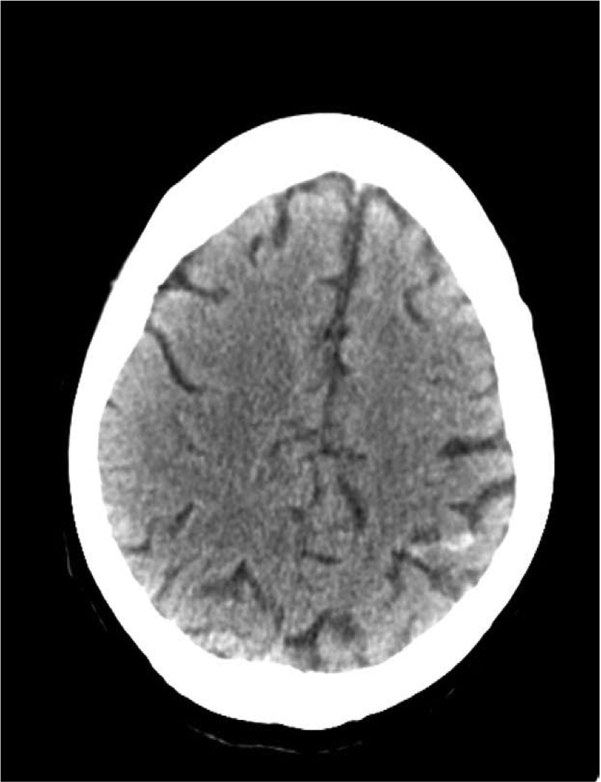
FIGURE 1
CASE THREE
Brain computerized tomogram postrecombinant tissue plasminogen activator showing left parietal subarachnoid hemorrhage.

Slide 23
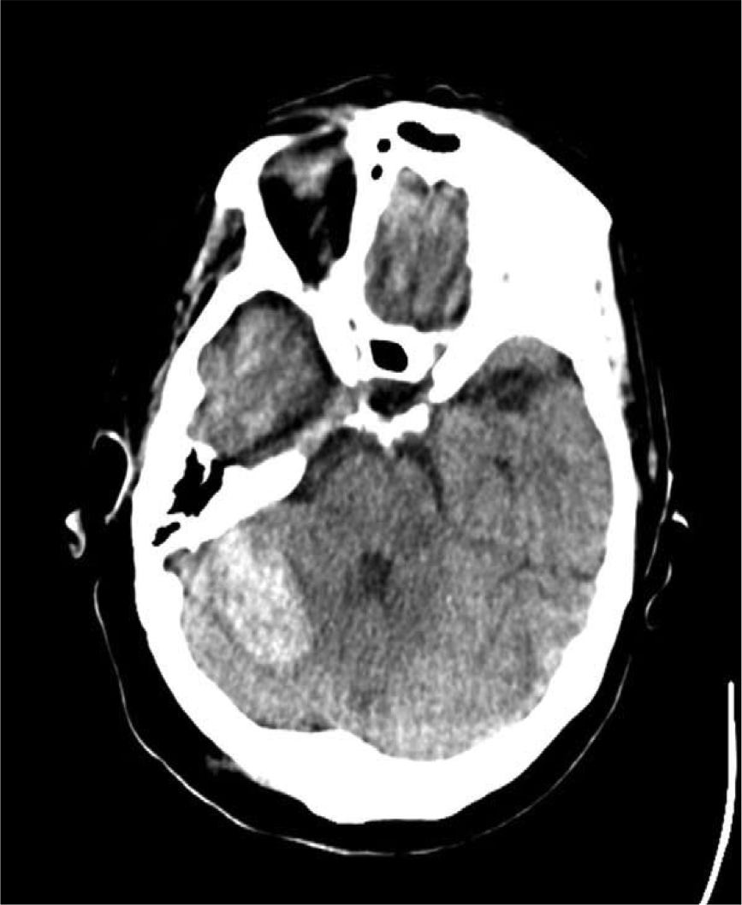
FIGURE 2
CASE THREE
Brain computerized tomogram postrecombinant tissue plasminogen activator showing right cerebellar intraparenchymal hemorrhage.

Slide 24
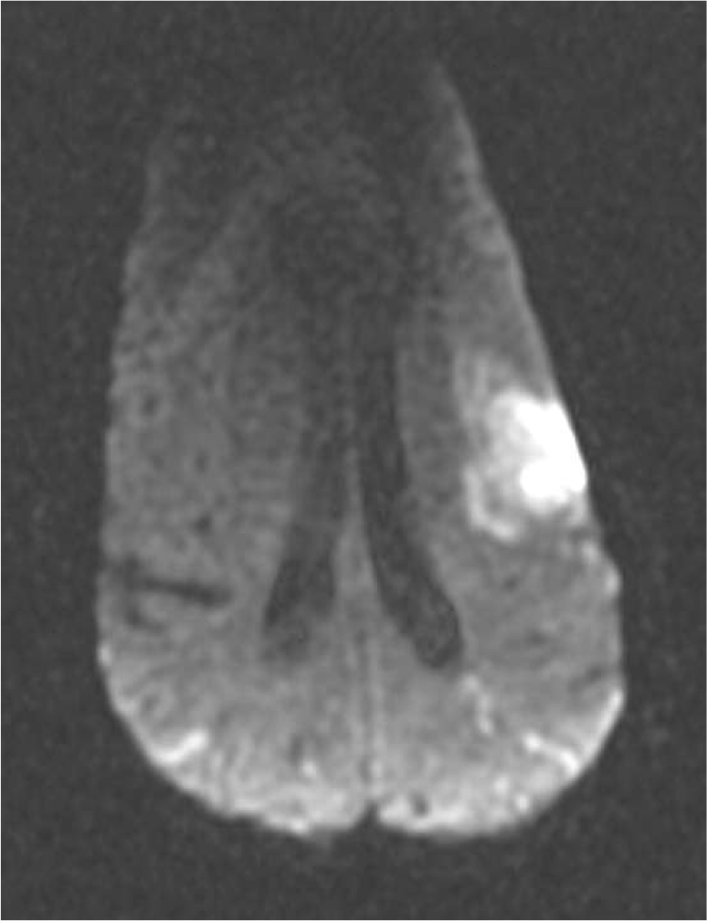
FIGURE 3
CASE THREE
Brain magnetic resonance imaging diffusion weighted sequence showing acute infarct in left frontal lobe with scattered infarcts in bilateral parietal lobes.

Slide 25
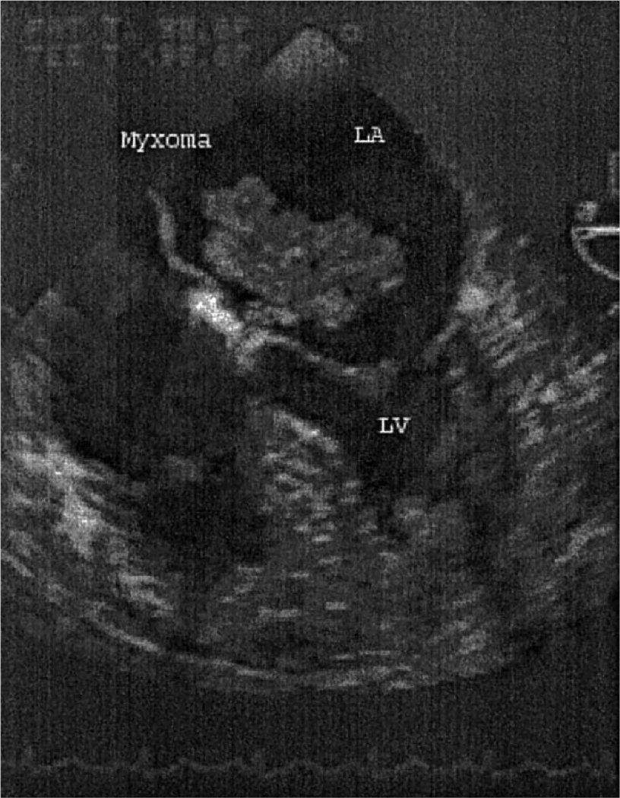
FIGURE 4
CASE THREE
Transesophageal echocardiogram showing left atrial myxoma.

Slide 26
CASE REPORT CONTINUED
CASE THREE
A repeated head CT showed a new right cerebellar hemorrhage and small left parietal subarachnoid hemorrhage, without any evidence of hemorrhagic conversion of the acute left frontal opercular infarct (Figs 1 and 2). She was given cryoprecipitate and fresh frozen plasma with no worsening of the hemorrhages or neurologic status. She improved during the course of 1 week to intact repetition but persistent dysfluency and impaired comprehension. Transesophageal echocardiography confirmed the presence of a large LA myxoma with extension of the tumor through a patent foramen ovale into the right atrium (Fig 3). Lower extremity Doppler showed no evidence of deep venous thrombosis. Magnetic resonance imaging confirmed the acute infarct in the left frontal region (Fig 4), several smaller foci of infarction in both hemispheres, and the hemorrhages seen on CT. Gradient echo sequences did not reveal areas of additional hemorrhage. Catheter cerebral angiography did not show any aneurysmal dilatation of cerebral vessels in the areas of the hemorrhage or elsewhere. The patient underwent resection of the myxoma 7 days after the stroke without any complications. Gross examination revealed a 3- 4-cm, very friable, and gelatinous mass that fragmented easily with minimal manipulation. Pathology confirmed atrial myxoma.

Slide 27
DISCUSSION
CASE THREE
Emboli from atrial myxomas may be composed of either thrombus, tumor itself, or both.² Tumor emboli from myxoma are unlikely to lyse with thrombolytic therapy. Intra-arterial urokinase has been used with partially successful recanalization of the right middle cerebral artery in one reported case.³ This suggests thrombi may contribute to vessel occlusion from myxoma, and in such cases thrombolysis may still be of benefit. Aneurysms and hemorrhage associated with stroke for patients with myxoma are well-established.⁴⁻⁶ In one series of 112 patients with LA myxoma, 24 of 33 with systemic emboli had stroke, and 3 of 24 with stroke (12.5%) had multiple cerebral aneurysms from cerebral emboli.⁷ Subarachnoid hemorrhage from rupture of an aneurysm secondary to myxoma has also been reported.6 Autopsy studies demonstrate myxomatous material in cerebral vessels with evidence of vessel wall inflammation,⁸ leading to vessel wall weakening and aneurysmal dilatation.

Slide 28
DISCUSSION
CASE THREE
Therefore, there is reason to be concerned about the risks of administering thrombolytic agents to patients with known myxomas. Ischemic strokes occurring secondary to bacterial endocarditis, for example, are considered a relative contraindication to the use of thrombolytic therapy because of the risk of hemorrhage from mycotic aneurysms.⁹ Guidelines about thrombolytic therapy in stroke do not address myxoma. The use of intra-arterial thrombolysis in patients with an atrial myxoma has been reported in two cases.^{3,10} One reported that intra-arterial rtPA administered within 3 hours of the onset of ischemic stroke effected partial recanalization and improvement in motor deficits. In the other case,¹⁰ a patient presenting with a right middle cerebral artery infarct received intra-arterial urokinase resulting in partial recanalization without clinical improvement. New intracranial hemorrhage was not reported in either of these patients. In our patient, treated not with intra-arterial but with intravenous thrombolysis, therapy was complicated by two hemorrhages–one parenchymatous and one subarachnoid–remote from the infarction. There was evidence of multiple other small infarcts on magnetic resonance imaging suggesting multiple emboli. It is possible the two hemorrhages in our patient were related to occult tumor emboli or microaneurysms not detected on angiogram.

Slide 29
DISCUSSION
CASE THREE
Because cerebral aneurysms may be present for patients with LA myxomas, the risk of cerebral hemorrhage after the administration of thrombolytic therapy for acute stroke may be higher than for patients without myxomas. The risk of hemorrhage may be particularly high for patients treated with intravenous, systemic thrombolytic agents. Intra arterial thrombolysis may be preferable in this setting because it also allows identification of aneurysms, which may lead to a decision to defer thrombolysis, or to an ability to focus treatment in the occluded artery, thereby avoiding areas more likely to bleed. It is unusual to know that a patient has a myxoma at the time of stroke. Nonetheless, we suggest that, as for bacterial endocarditis, known myxoma be considered a relative contraindication to intravenous thrombolytic therapy for ischemic stroke. Intra-arterial thrombolysis may be the preferred treatment in this situation.

Slide 30
REFERENCES
CASE THREE
Knepper LE, Biller J, Adams HP, et al. Neurologic manifestations of atrial myxoma: A 12-year experience and review. Stroke 1998;19:1435-1440.
Wold LE, Lie JT. Cardiac myxomas: A clinicopathologic profile. Am J Pathol 1980;101:219-240.
Bekavac I, Hanna JP, Wallace RC, et al. Intra-arterial thrombolysis of embolic proximal middle cerebral artery occlusion from presumed atrial myxoma. Neurology 1997;49:618-620.
O’Rourke F, Dean N, Mouradian MS, et al. Atrial myxoma as a cause of stroke: Case report and discussion. CMAJ 2003;169:1049-1051.
Damasio H, Seabra-Gomes R, da Silva JP, et al. Multiple cerebral aneurysms and cardiac myxoma. Arch Neurol 1975;32:269-270.
Price DL, Harris JL, New PF, et al. Cardiac myxoma: A clinicopathologic and angiographic study. Arch Neurol 1970;23:558-567.
Pinede L, Duhaut P, Loire R. Clinical presentation of left atrial cardiac myxoma: A series of 112 consecutive cases. Medicine (Baltimore) 2001;80:159-172.
Hutton JT. Atrial myxoma as a cause of progressive dementia. Arch Neurol 1981;38:533.
Activase rt-PA [product monograph]. San Francisco, CA: Genentech; 2001.
Yamanome T, Yoshida K, Miura K, et al. Superselective
fibrinolysis for a middle cerebral artery embolism caused by a left atrial myxoma: Case report. No Shinkei Geka 2000;28:653-658. Figure 4. Transesophageal echocardiogram showing left atrial myxoma.

Slide 31

CASE FOUR
ATRIAL FIBRILLATION
Continuous monitoring: uncovering AF in CS
Authors: Shyam Prabhakaran, MD, MS Professor of Neurology Director, Stroke Research Northwestern University

Slide 32
CASE REPORT
CASE FOUR
56 year old female, no risk factors
Presented with right motor deficits
MRI/MRA showed left thalamic infarct with thrombus in PCA
Negative work-up
  Normal TTE/TEE
  No AF on several days of telemetry
Implanted insertable cardiac monitor
  AF detected at 60 days post-stroke
Started on apixaban for stroke prevention

Slide 33
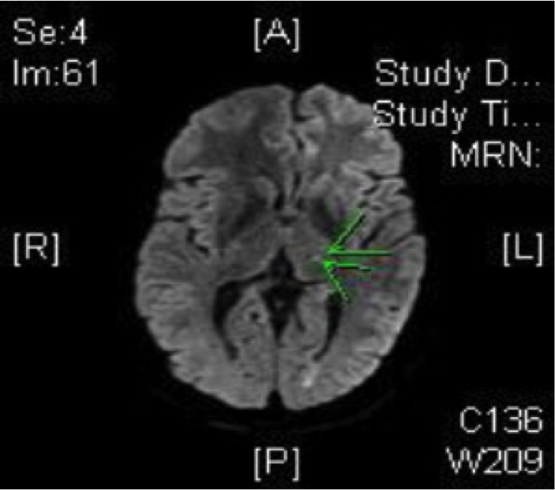
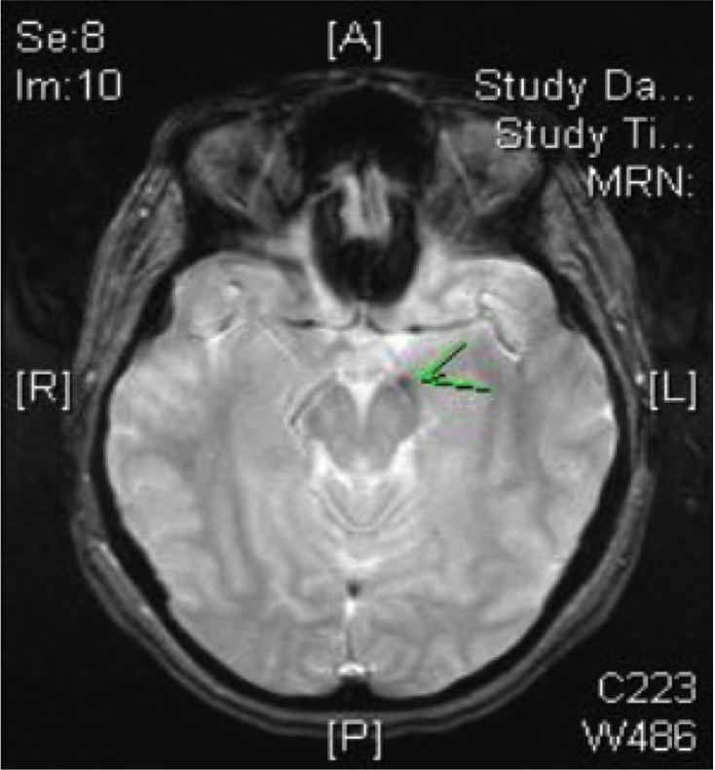
FIGURE 1
CASE FOUR
Small stroke, but thrombus suggested embolism

Slide 34

CASE FIVE
PFO
Bubble study: diagnosing PFO in CS
Authors: Shyam Prabhakaran, MD, MS Professor of Neurology Director, Stroke Research Northwestern University

Slide 35
CASE REPORT
CASE FIVE
53 year old male, no risk factors
Presented with right hemiparesis and aphasia
MRI showed left MCA stroke
Work-up
  Normal MRA head/neck
  No AF on 30-day monitoring
TTE and TEE showed large PFO
Referred to Cardiology for PFO closure

Slide 36
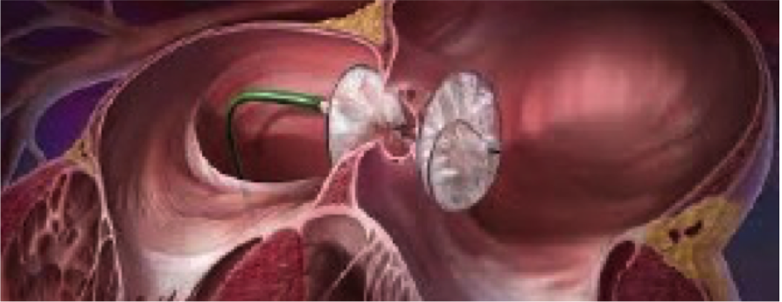
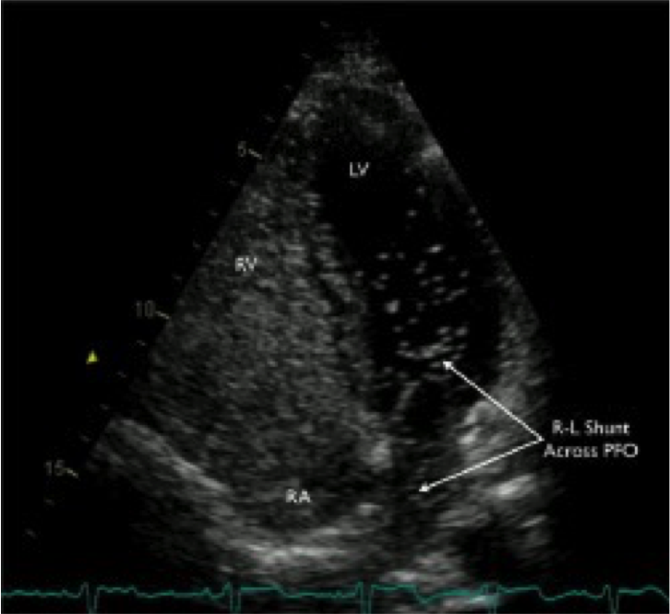
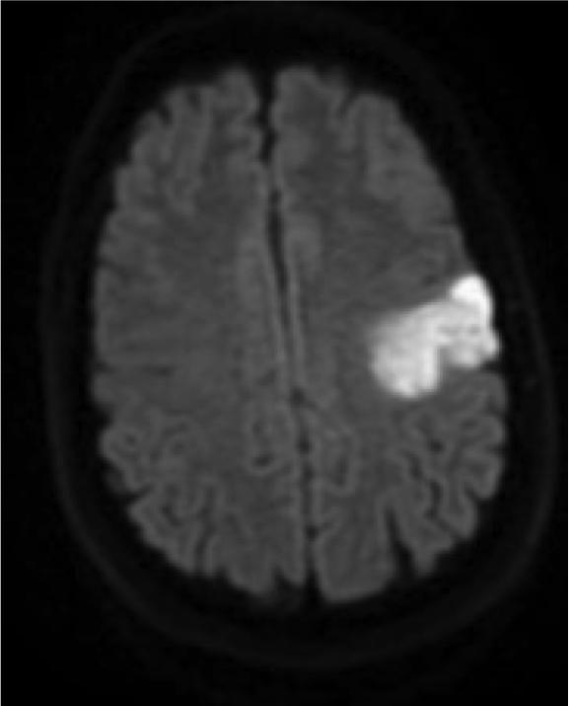
FIGURE 1
CASE FIVE
PFO Closure

