Slide 1
Addressing Patients with Cryptogenic Stroke
Epidemiology, Pathophysiology, Diagnosis and Follow-up for Patients with Unknown Stroke Etiology

Slide 2

Stroke as a Health care Issue in the U.S.
≈795,000,000
new or recurrent strokes yearly
87% ischemic stroke
13% hemorrhagic stroke
5th leading cause of death
A leading cause
of serious long-term disability in the U.S.
Virani SS, et al. (2021) Circulation.
Notes:
Source: Virani SS, Alonso A, Aparacio HJ, et al, On behalf of the American Heart Association Council on Epidemiology and Prevention Statistics Committee and Stroke Statistics Subcommittee. Heart disease and stroke statistics-2021 update: a report from the American Heart Association. Circulation. 2021;143:e00–e00.

Slide 3

Disability Associated With Ischemic Stroke
Remaining hemiparesis
Inability to walk without assistance/high risk for falls
Cognitive deficits
Depressive symptoms
Aphasia
Dependency on others
Institutionalized
Winstein (2016) Circulation.
Notes:
Stroke has serious long-term consequences. Subsequent strokes are often more severe so it’s important to take steps to prevent a recurrent stroke.
Source:
Winstein CJ, Stein J, Arena R, Bates B, Cherney LR, Cramer SC, Deruyter F, Eng JJ, Fisher B, Harvey RL, Lang CE, MacKay-Lyons M, Ottenbacher KJ, Pugh S, Reeves MJ, Richards LG, Stiers W, Zorowitz RD; on behalf of the American Heart Association Stroke Council, Council on Cardiovascular and Stroke Nursing, Council on Clinical Cardiology, and Council on Quality of Care and Outcomes Research. Guidelines for adult stroke rehabilitation and recovery: a guideline for healthcare professionals from the American Heart Association/American Stroke Association. Stroke. 2016;47:e98–e169. DOI: 10.1161/STR.0000000000000098. Expert peer review of AHA Scientific Statements is conducted by the AHA Office of Science Operations. For more

Slide 4
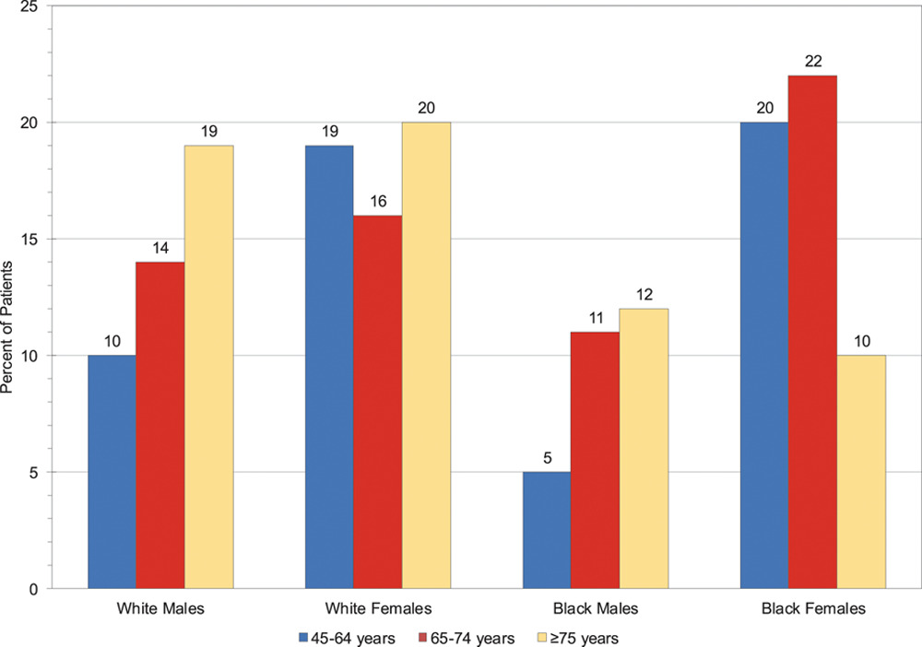
Importance of Secondary Ischemic Stroke Prevention
Percent of Stroke Patients With Recurrent Stroke Within 5 Years After First Stroke, 1995 to 2011
Nearly 1 in 4 strokes in the
U.S. each year is a recurrent stroke.
Virani SS, et al. (2021) Circulation.
Notes:
Source: Virani SS, Alonso A, Aparacio HJ, et al, On behalf of the American Heart Association Council on Epidemiology and Prevention Statistics Committee and Stroke Statistics Subcommittee. Heart disease and stroke statistics-2021 update: a report from the American Heart Association. Circulation. 2021;143:e00–e00.
Probability of recurrent stroke in 5 years after first stroke, United States, 1995 to 2011.*
*Data years 1986 to 2011 for those who were 45 to 64 years of age because of the small number of events.
Source: Unpublished National Heart, Lung, and Blood Institute (NHLBI) tabulation using pooled data from the Framingham Heart Study, Atherosclerosis Risk in Communities Study, Cardiovascular Health Study, Multi-Ethnic Study of Atherosclerosis, Coronary Artery Risk Development in Young Adults, and Jackson Heart Study of the NHLBI.

Slide 5
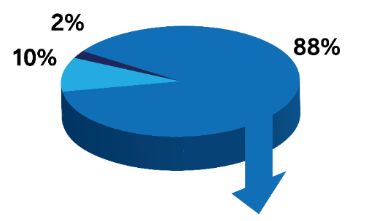
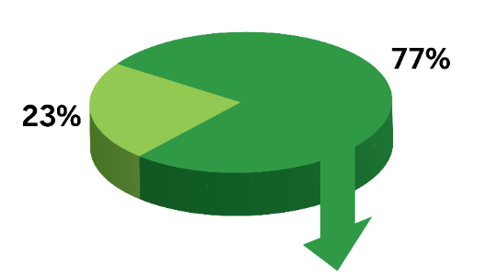
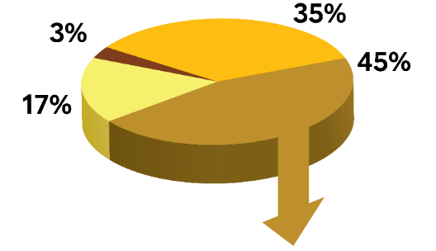
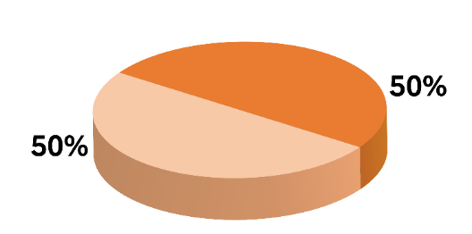
Cryptogenic Stroke Incidence in the U.S.
Intracerebral Hemorrhage
Subarachnoid Hemorrhage
More than 690,000 ischemic strokes every year in the U.S.¹
      A leading cause of disability in the U.S. and worldwide
Cryptogenic strokes account for about
1 in 3 (35%) ischemic strokes²
Embolic strokes of undetermined source (ESUS) account for ≈50% of cryptogenic strokes²
Stroke
Ischemic Stroke
Lacunar
Ischemic Stroke
Non-Lacunar
Cardioembolic
Non-Lacunar Stroke
Large Artery
Cryptogenic
Other
Cryptogenic Stroke
ESUS
NON-ESUS
1. Virani SS et al (2021);Circulation. 2. Kleindorfer DO et al (2021);Stroke.
Notes:
Full reference information:
1. Virani SS, Alonso A, Aparacio HJ, et al, On behalf of the American Heart Association Council on Epidemiology and Prevention Statistics Committee and Stroke Statistics Subcommittee. Heart disease and stroke statistics-2021 update: a report from the American Heart Association. Circulation. 2021;143:e00–e00.
2. Kleindorfer DO, Towfighi A, Chaturvedi S, et al. 2021 Guideline for the Prevention of Stroke in Patients with Stroke and Transient Ischemic Attack: A Guideline from the American Heart Association/American Stroke Association. Stroke. 2021;52:e364–e467.

Slide 6
Treatment implications of cryptogenic stroke
The ability to more clearly define the etiology of cryptogenic stroke and previously unknown risk factors has implications for subsequent treatment and risk for recurrent events. Secondary prevention strategies should be tailored to the ischemic stroke subtype.
Most cryptogenic stroke patients receive antiplatelet therapy for secondary prevention,¹ treatment that is not effective in preventing strokes of cardioembolic origin
Long-term monitoring reveals AF in up to 30% of cryptogenic stroke patients²
      These patients might benefit from anticoagulant therapy.
3. Søndergaard L et al. (2017);N Engl J Med. 4. Sanna T et al. (2014);N Engl J Med.
Notes:
Full reference information:
1. Lars Søndergaard, M.D., Scott E. Kasner, M.D., John F. Rhodes, M.D., Grethe Andersen, M.D., D.M.Sc., Helle K. Iversen, M.D., D.M.Sc., Jens E. Nielsen-Kudsk, M.D., D.M.Sc., Magnus Settergren, M.D., Ph.D., Christina Sjöstrand, M.D., Ph.D., Risto O. Roine, M.D., David Hildick-Smith, M.D., J. David Spence, M.D., and Lars Thomassen, M.D. for the Gore REDUCE Clinical Study Investigators. Patent Foramen Ovale Closure or Antiplatelet Therapy for Cryptogenic Stroke. N Engl J Med 2017; 377:1033-1042.
2. Sanna T, Diener HC, Passman RS, et al. Cryptogenic stroke and underlying atrial fibrillation. N Engl J Med. 2014;370:2478-2486.

Slide 7
Definitions of Cryptogenic Stroke
AHA/ASA 2021 Guideline for the Prevention of Stroke in Patients with Stroke and TIA defines cryptogenic stroke as “an imaging-confirmed stroke with unknown source despite thorough diagnostic assessment (including, at a minimum, arterial imaging, echocardiography, extended rhythm monitoring, and key laboratory studies such as a lipid profile and hemoglobin A1c [HbA1c]).¹
CLASSIFICATION SCHEME | REQUIRED WORKUP
TOAST² | Not specified
Causative Classification of Stroke (CCS)³ | Brain CT/MRI, 12-lead ECG, precordial echocardiogram, extra/intravascular imaging
Embolic Strokes of Undetermined Source⁴ | Brain CT/MRI, 12-lead ECG, precordial echocardiogram, extra/intravascular imaging, cardiac monitoring for ≥24 hours
ASCOD Phenotyping⁵ | Does not include a cryptogenic stroke category
TOAST defines cryptogenic stroke (stroke of undetermined etiology) as brain infarction that is not attributable to a definite cardioembolism, large artery atherosclerosis or small artery disease despite extensive vascular, cardiac and serologic evaluation.
1. Kleindorfer DO et al. (2021);Stroke. 2. Adams HP et al. (1993);Stroke. 3. Arsava EM et al. (2010);Neurology. 4. Hart RG et al. (2014);Lancet Neurol. 5. Amarenco P et al. (2013);Cerebrovasc Dis.
Notes:
Full reference information:
Kleindorfer DO, Towfighi A, Chaturvedi S, et al. 2021 Guideline for the Prevention of Stroke in Patients with Stroke and Transient Ischemic Attack: A Guideline from the American Heart Association/American Stroke Association. Stroke. 2021;52:e364–e467.
2. Adams HP Jr, Bendixen BH, Kappelle LJ, Biller J, Love BB, Gordon DL, Marsh EE 3rd. Classification of subtype of acute ischemic stroke. Definitions for use in a multicenter clinical trial. TOAST. Trial of Org 10172 in Acute Stroke Treatment. Stroke. 1993 Jan;24(1):35-41. https://www.ahajournals.org/doi/pdf/10.1161/01.STR.24.1.35
3. Arsava EM et al. The Causative Classification of Stroke system An international reliability and optimization study. Neurology 2010;75:1277–1284 https://www.ncbi.nlm.nih.gov/pmc/articles/PMC3013495/pdf/8084.pdf
4. Hart RG1, Diener HC2, Coutts SB3, Easton JD4, Granger CB5, O'Donnell MJ6, Sacco RL7, Connolly SJ8; Cryptogenic Stroke/ESUS International Working Group. Embolic strokes of undetermined source: the case for a new clinical construct. Lancet Neurol. 2014 Apr;13(4):429-38. doi: 10.1016/S1474-4422(13)70310-7. https://www.ncbi.nlm.nih.gov/pubmed/24646875
5. Amarenco P, Bogousslavsky J, Caplan LR, Donnan GA, Wolf ME, Hennerici MG. The ASCOD phenotyping of ischemic stroke (Updated ASCO Phenotyping). Cerebrovasc Dis. 2013;36(1):1-5. doi: 10.1159/000352050. Epub 2013 Jul 30. https://www.karger.com/Article/Pdf/352050

Slide 8
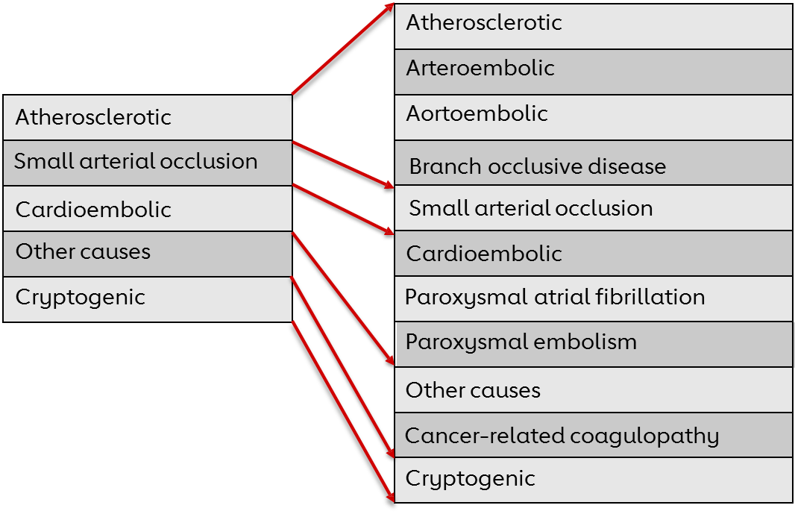
Cryptogenic Stroke Is a Diagnosis of Exclusion
Adapted from: Bang OY et al. (2014);Stroke.
Notes:
Full reference information:
Oh Young Bang, MD, PhD; Bruce Ovbiagele, MD; Jong S. Kim, MD, PhD. Evaluation of Cryptogenic Stroke With Advanced Diagnostic Techniques. (Stroke. 2014;45:1186-1194.) DOI: 10.1161/STROKEAHA.113.003720

Slide 9
Potential Etiologies of Cryptogenic Stroke

Slide 10
Potential Etiologies of Cryptogenic Stroke
Patent Foramen Ovale (PFO)
Occult Paroxysmal Atrial Fibrillation
Hypercoagulable States
Aortic Arch Atheroma
Cardiac Tumors
Dissection
Malignancy
Vasculitis
1. Yaghi S et al. (2017);Circ Research. 2. Kleindorfer DO et al. (2021);Stroke.
Notes:
Full reference information:
1. Shadi Yaghi, Richard A. Bernstein, Rod Passman, Peter M. Okin, Karen L. Furie. Cryptogenic Stroke Research and Practice. Circulation Research. 2017; 527-540. DOI: 10.1161/CIRCRESAHA.116.308447.
2. Kleindorfer DO, Towfighi A, Chaturvedi S, et al. 2021 Guideline for the Prevention of Stroke in Patients with Stroke and Transient Ischemic Attack: A Guideline from the American Heart Association/American Stroke Association. Stroke. 2021;52:e364–e467.

Slide 11
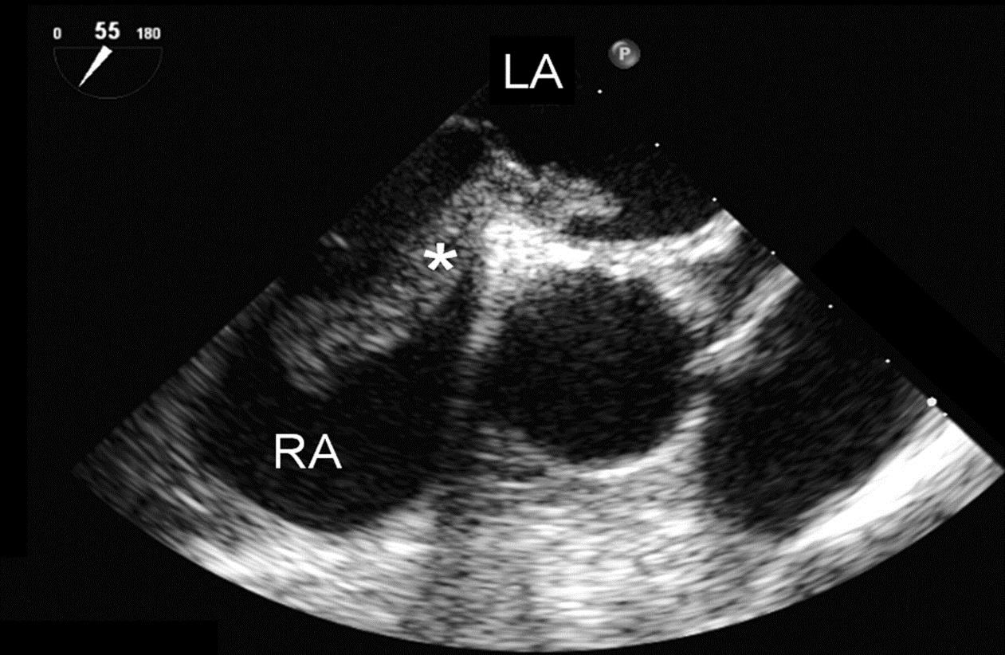
Potential Etiologies: Patent Foramen Ovale (PFO)
PFO is seen in up to 25% of adults — and in 40% of cryptogenic stroke patients.^{1,2}
PFO is an embryonic defect and is characterized by an opening in the septum between the atria; this opening provides a conduit for emboli derived from the deep veins of the pelvis or legs to the brain.³
The prevalence of PFO has been shown to be higher in young adults with cryptogenic stroke. ³
Transesophogeal echocardiography in a 55° view.
PFO with large mobile thrombus (*) as seen across the foramen ovale.⁴
1. Saver, JL. (2016);N Engl J Med. 2. Kleindorfer DO et al. (2021);Stroke. 3. Kernan WN et al. (2014);Stroke. 4. Najem B et al. (2008);Circulation.
Notes:
Sources:
Jeffrey L. Saver, M.D. Cryptogenic Stroke. N Engl J Med. 2016;374:2065-74.
Kleindorfer DO, Towfighi A, Chaturvedi S, et al. 2021 Guideline for the Prevention of Stroke in Patients with Stroke and Transient Ischemic Attack: A Guideline from the American Heart Association/American Stroke Association. Stroke. 2021;52:e364–e467.
Kernan WN, Ovbiagele B, Black HR, Bravata DM, Chimowitz MI, Ezekowitz MD, Fang MC, Fisher M, Furie KL, Heck DV, Johnston SC, Kasner SE, Kittner SJ, Mitchell PH, Rich MW, Richardson D, Schwamm LH, Wilson JA; on behalf of the American Heart Association Stroke Council, Council on Cardiovascular and Stroke Nursing, Council on Clinical Cardiology, and Council on Peripheral Vascular Disease. Guidelines for the prevention of stroke in patients with stroke and transient ischemic attack: a guideline for healthcare professionals from the American Heart Association/American Stroke Association. Stroke. 2014;45:2160–2236.
4. Boutaïna Najem, MD; Eve Lefrancq, MD; Philippe Unger, MD, PhD. Thrombus Trapped in Patent Foramen Ovale and Bilateral Pulmonary Embolism; A One-Stop Shop Ultrasound Diagnosis. Circulation. 2008;118:e154-e155. https://www.ahajournals.org/doi/pdf/10.1161/circulationaha.108.777433

Slide 12
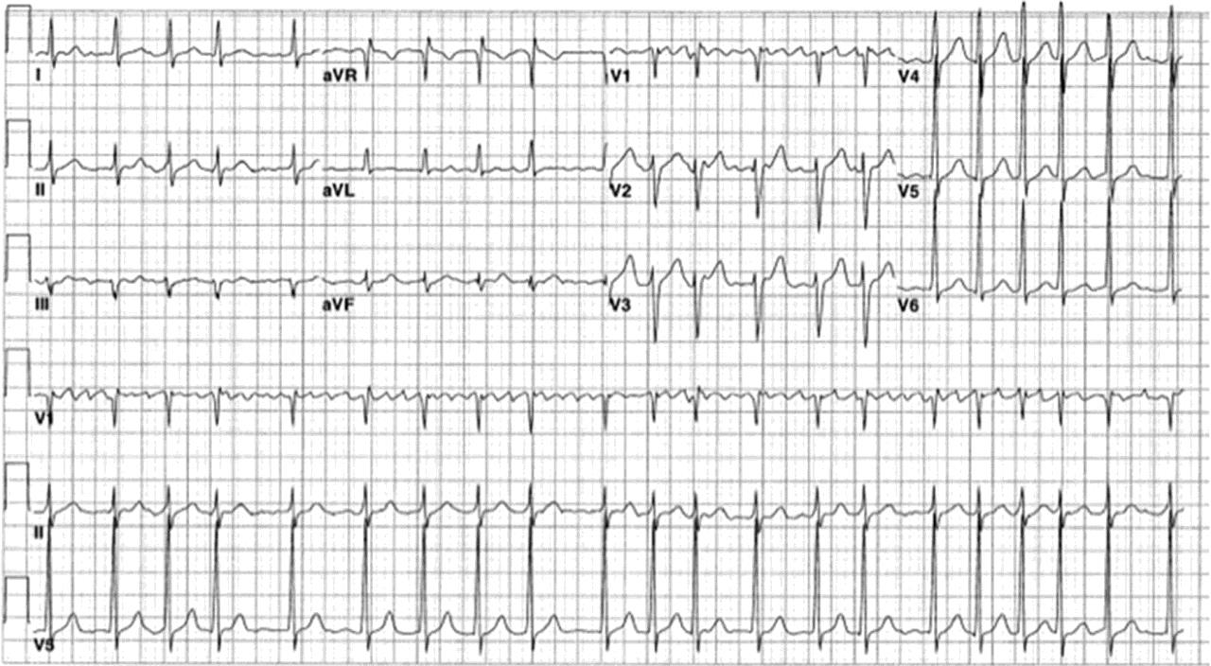
Potential Etiologies: Occult Paroxysmal Atrial Fibrillation
Detection of AF is important as a part of the workup of cryptogenic stroke in order to identify patients who might benefit from anticoagulant over antiplatelet therapy.
AF is often paroxysmal and asymptomatic, and thus may not be detected by short- or intermediate-term cardiac monitoring modalities.
Technologies available for extended cardiac monitoring include:
    continuous telemetry,
    ambulatory electrocardiography,
    serial ECGs,
    transtelephonic ECG monitoring, and
    insertable cardiac monitors (i.e. loop recorders).
The 12-lead ECG showing atrial fibrillation with a rapid ventricular rate³
1. Bang OY et al. (2014);Stroke. 2. Yaghi S, Elkind M. (2014);Neurology Clinical Practice. 3. Chintz JS et al. (2013);Circulation.
Notes:
Full reference information:
1. Oh Young Bang, MD, PhD; Bruce Ovbiagele, MD; Jong S. Kim, MD, PhD. Evaluation of Cryptogenic Stroke With Advanced Diagnostic Techniques. (Stroke. 2014;45:1186-1194.) DOI: 10.1161/STROKEAHA.113.003720
2. Cryptogenic stroke. Shadi Yaghi, Mitchell S.V. Elkind. Neurol Clin Pract Oct 2014, 4 (5) 386-393; DOI: 10.1212/CPJ.0000000000000086 https://www.ncbi.nlm.nih.gov/pmc/articles/PMC4196459/
3. Jason S. Chinitz, MD; Prashant Vaishnava, MD; Rajeev L. Narayan, MD; Valentin Fuster, MD, PhD. Atrial Fibrillation Through the Years: Contemporary Evaluation and Management. Circulation. 2013;127:408-416.

Slide 13
Risk for Stroke in Patients With AF
2x
5x
64%
Ischemic stroke associated with AF is nearly twice as likely to be fatal as non-AF stroke²
Well-established data indicate that AF is associated with a
5-fold increase in the
risk for ischemic stroke¹
In patients with AF, treatment with oral anticoagulant decreases the risk
for stroke by 64% compared with placebo³
1. Wolf PA et al. (1987);Arch Intern Med. 2. Lin HJ et al. (1996);Stroke. 3. Hart RG et al. (2007);Ann Intern Med.
Notes:
Full reference information:
Wolf PA, Abbott RD, Kannel WB. Atrial fibrillation: a major contributor to stroke in the elderly. The Framingham Study. Arch Intern Med. 1987 Sep;147(9):1561-4.
Lin HJ1, Wolf PA, Kelly-Hayes M, Beiser AS, Kase CS, Benjamin EJ, D'Agostino RB. Stroke severity in atrial fibrillation. The Framingham Study. Stroke. 1996 Oct;27(10):1760-4. https://www.ncbi.nlm.nih.gov/pubmed/8841325
Hart RG, Pearce LA, Aguilar MI. Meta-analysis: antithrombotic therapy to prevent stroke in patients who have nonvalvular atrial fibrillation. Ann Intern Med. 2007 Jun 19;146(12):857-67. Meta-analysis: antithrombotic therapy to prevent stroke in patients who have nonvalvular atrial fibrillation - PubMed (nih.gov)

Slide 14
Potential Etiologies: Hypercoagulable States
Hypercoagulable or thrombophilic states refer to genetic or acquired conditions that a predisposition to form blood clots inappropriately and are characterized by deficiencies and mutations in endogenous anticoagulants.
Included in the list of thrombophilias that may predispose to stroke are:
    protein C deficiency,
    protein S deficiency,
    antithrombin deficiency,
    factor V Leiden,
    prothrombin G20210A mutation, and
    methylenetetrahydrofolate reductase (MTHFR) C677T mutation.
Such deficiencies may be related to the cause of cryptogenic stroke.
Among patients in whom other causes have not been found, screening for inherited thrombophilias may be worthwhile.
Kleindorfer DO et al. (2021);Stroke.
Notes:
Source:
Kleindorfer DO, Towfighi A, Chaturvedi S, et al. 2021 Guideline for the Prevention of Stroke in Patients with Stroke and Transient Ischemic Attack: A Guideline from the American Heart Association/American Stroke Association. Stroke. 2021;52:e364–e467.

Slide 15
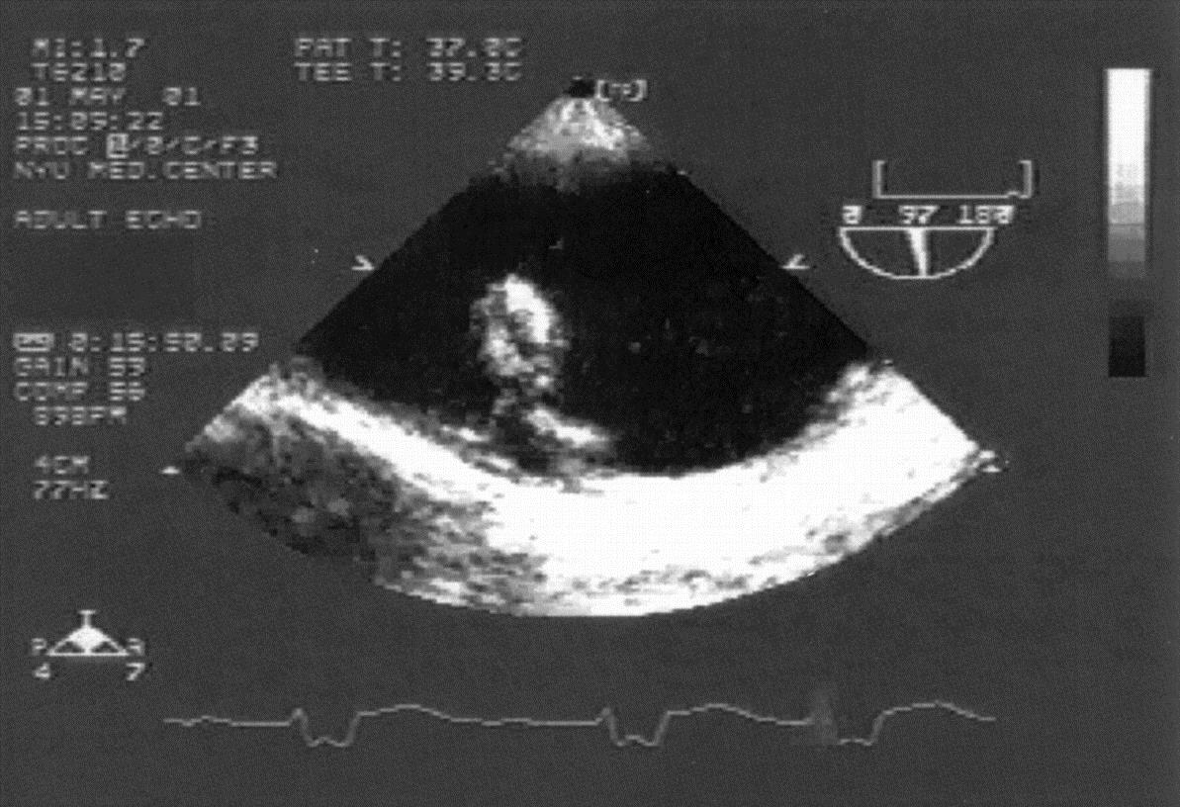
Potential Etiologies: Aortic Arch Atheroma
Some evidence from retrospective studies suggests a causal association between atherosclerotic disease of the aortic arch (atheroma or plaque) and increased risk for ischemic stroke.¹
Aortic arch plaque has been shown independently with an increased risk for stroke.²
TEE showing aortic arch with very severe atherosclerotic plaque²
1. Amarenco P et al. (1992);N Engl J Med. 2. Di Tullio MR et al. (2009);Circulation. 3. Kronzon I and Tunick PA. (2006);Circulation.
Notes:
Sources:
1. Amarenco P, Duyckaerts C, Tzourio C, Hénin D, Bousser MG, Hauw JJ. The prevalence of ulcerated plaques in the aortic arch in patients with stroke. NEngl J Med. 1992;326:221–225.
2. Di Tullio MR, Russo C, Jin Z, Sacco RL, Mohr JP, Homma S; Patent Foramen Ovale in Cryptogenic Stroke Study Investigators. Aortic arch plaques and risk of recurrent stroke and death. Circulation. 2009;119:2376–2382.
3. Itzhak Kronzon, MD; Paul A. Tunick, MD. Aortic Atherosclerotic Disease and Stroke. Circulation. 2006;114:63-75.

Slide 16
Potential Etiologies: Cardiac Tumors & Malignancy
Patients with cancer are at high-risk for stroke, with cancer as a comorbidity found in 10% of hospitalized patients with ischemic stroke in the U.S.¹
There are numerous potential mechanisms for ischemic stroke in these patients, including procoagulant conditions.
Primary cardiac tumors are uncommon,² but patients with cardiac tumors are at increased risk for stroke, with an overall rate of embolism of 25%.³
1. Dardiotis E et al. (2019); Int J Oncol. 2. Reynen K. (1996);Am J Cardiol. 3. Lai MM et al. (2015); Int J Stroke.
Notes:
Sources:
1. Dardiotis E, Aloizou AM, Markoula S, et al. Cancer-associated stroke: pathophysiology, detection and management (review). Int J Oncol. 2019;54:779–796.
2. Reynen K. Frequency of primary tumors of the heart. Am J Cardiol. 1996;77:107.
3. Lai MM, Li TC, Lin CL, et al. Benign neoplasm of the heart increases the risk of first ischemic stroke: a population-based cohort study. Int J Stroke. 2015;10:202–206.

Slide 17
Potential Etiologies: Dissection
Extracranial carotid or vertebral dissections are a relatively uncommon mechanism of ischemic stroke that can be the result of trauma or spontaneous and are found mostly in younger patients.¹
1. Redekop GJ. (2008); Can J Neurol Sci.
Notes:
Source:
Redekop GJ. Extracranial carotid and vertebral artery dissection: a review. Can J Neurol Sci. 2008;35:146–152.

Slide 18
Potential Etiologies: Vasculitis
There are various types of vasculitis, including:
    Autoimmune vasculitis—Overall prevalence of autoimmune vasculitis in stroke population is very low but age dependent. In cohorts of younger patients (eg, age <45 years), vasculitis may account for 0% to 20% of stroke cases, depending on depth of workup.¹
    Infectious vasculitis—Infectious diseases such as varicella zoster virus (VZV) cerebral vasculitis, neurosyphilis, or bacterial meningitis may cause stroke through various mechanisms.²
    Neoplastic vasculitis—Refers to inflammation of the brain arteries resulting from direct invasion of neoplastic cells. Conditions in this category are rare & include lymphomatoid granulomatosis & angiotropic or intravascular lymphoma (also known as angioendotheliomatosis).³
1. Varona JF. (2007); Eur Neurol.. 2. Kleindorfer DO. (2021);Stroke. 3. Fonkem E et al. (2016);BMC Neurol.
Notes:
Sources:
1. Varona JF, Guerra JM, Bermejo F, Molina JA, Gomez de la Cámara A. Causes of ischemic stroke in young adults, and evolution of the etiological diagnosis over the long term. Eur Neurol. 2007;57:212–218.
2. Kleindorfer DO, Towfighi A, Chaturvedi S, et al. 2021 Guideline for the Prevention of Stroke in Patients with Stroke and Transient Ischemic Attack: A Guideline from the American Heart Association/American Stroke Association. Stroke. 2021;52:e364–e467.
3. Fonkem E, Dayawansa S, Stroberg E, Lok E, Bricker PC, Kirmani B, Wong ET, Huang JH. Neurological presentations of intravascular lymphoma (IVL): meta-analysis of 654 patients. BMC Neurol. 2016;16:9.

Slide 19
Diagnosing
Cryptogenic Stroke

Slide 20
Diagnosis of Cryptogenic Stroke:
Algorithm for evaluating patients
NO
Consider delayed reimaging with CT or MRI if not done initially (Class 2a)
Shows
ischemic
stroke†
CT or MRI
shows ischemic
stroke mimic
CT or MRI (Class 1)
NO
YES
YES
Manage accordingly
Anterior
circulation
infarct
ECG and basic laboratory tests*
(Class 1)
Echocardiography to evaluate for cardiac SOE (Class 2a)
YES
NO
Non-invasive intracranial and extracranial imaging of
vertebrobasilar arterial system
(Class 2a)
Non-invasive cervical carotid
imaging [CTA, MRA, or US]
(Class 1)
Non-invasive intracranial arterial imaging (Class 2a)
Long-term cardiac rhythm monitoring (Class 2a)
Cause
identified
Based on age,
medical comorbidities and clinical syndrome, consider:
Test for genetic stroke syndrome (Class 2a)
Manage accordingly
YES
NO
Test for infectious vasculitis (Class 2a)
TEE, Cardiac CT or Cardiac MRI (Class 2b)
Evaluate for other rare causes of stroke
Abbreviations: CT indicates computed tomography; CTA, computed tomography angiogram; ECG, electrocardiogram; MRA, magnetic resonance angiography; MRI, magnetic resonance imaging; SOE, source of embolism; TEE, transesophageal echo; TIA; transient ischemic attack: and US, ultrasound. †When a patient has a transient neurological deficit clinically characteristic of transient ischemic attack, the patient should be evaluated in the same manner as a patient who has an ischemic stroke with a corresponding cerebral infarct on imaging.
Kleindorfer DO et al. (2021);Stroke
Notes:
Source:
Kleindorfer DO, Towfighi A, Chaturvedi S, et al. 2021 Guideline for the Prevention of Stroke in Patients with Stroke and Transient Ischemic Attack: A Guideline from the American Heart Association/American Stroke Association. Stroke. 2021;52:e364–e467.

Slide 21
Diagnosis of Cryptogenic Stroke: Initial Workup
Guideline baseline evaluations at a minimum for all strokes, should include:
Noncontrast brain CT or brain MRI → to confirm diagnosis of stroke
Basic laboratory tests:
  Blood glucose
  Hemoglobin A1C
  Oxygen saturation
  Serum electrolytes/renal function tests
  Complete blood count, including platelet count
  Markers of cardiac ischemia (troponin)
  Prothrombin time/International Normalized Ratio (INR)
  Activated partial thromboplastin time
  Fasting or nonfasting lipid profile
Electrocardiogram → to screen for AF, atrial flutter & other cardiac conditions
Kleindorfer DO et al (2021);Stroke.
Notes:
Kleindorfer DO, Towfighi A, Chaturvedi S, et al. 2021 Guideline for the Prevention of Stroke in Patients with Stroke and Transient Ischemic Attack: A Guideline from the American Heart Association/American Stroke Association. Stroke. 2021;52:e364–e467.

Slide 22
ADDITIONAL WORKUP: Neuroimaging
If initial imaging was inconclusive, a follow-up CT or MRI of the brain should be considered to confirm the diagnosis of ischemic stroke or TIA and to help identify potential causes.
2021 AHA/ASA Guideline Recommendations¹:
In patients suspected of having ischemic stroke, if CT or MRI does not demonstrate symptomatic cerebral infarct, follow-up CT or MRI of the brain is reasonable to confirm diagnosis. (Class 2a, LOE B-NR)
In patients suspected of having had a TIA, if the initial head imaging (CT or MRI) does not demonstrate a symptomatic cerebral infarct, follow-up MRI is reasonable to predict risk of early stroke and to support the diagnosis. (Class 2a, LOE B-NR)
MRI has similar sensitivity for acute intracranial hemorrhage as CT, but may offer benefits over CT in detecting ischemic stroke and identifying potential causes.²
1. Kleindorfer DO et al. (2021);Stroke. 2. Yaghi S et al. (2014);Neurol Clin Pract.
Notes:
Full reference information:
Kleindorfer DO, Towfighi A, Chaturvedi S, et al. 2021 Guideline for the Prevention of Stroke in Patients with Stroke and Transient Ischemic Attack: A Guideline from the American Heart Association/American Stroke Association. Stroke. 2021;52:e364–e467.
Yaghi S, Elkind MS. Cryptogenic stroke: A diagnostic challenge. Neurol Clin Pract. 2014;4:386-393.

Slide 23
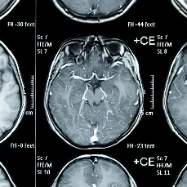
ADDITIONAL WORKUP: Vascular Imaging
When a stroke etiology has not been identified during initial evaluation, vascular imaging is recommended for identifying large-vessel atherosclerotic disease or dissection.
2021 AHA/ASA Guideline Recommendations¹:
In patients with symptomatic anterior circulation cerebral infarction or TIA who are candidates for revascularization, noninvasive cervical carotid imaging with carotid ultrasonography, CT angiography (CTA), or magnetic resonance angiography (MRA) is recommended to screen for stenosis. (Class 1, LOE B-NR)
In patients with ischemic stroke or TIA,noninvasive imaging of the intracranial large arteries and imaging of the extracranial vertebrobasilar arterial system with MRA or CTA can be effective to identify atherosclerotic disease, dissection, moyamoya, or other etiologically relevant vasculopathies. (Class 2a, LOE C-LD)
1. Kleindorfer DO et al. (2021);Stroke. 2. Yaghi S et al. (2014);Neurol Clin Pract.
Notes:
Full reference information:
Kleindorfer DO, Towfighi A, Chaturvedi S, et al. 2021 Guideline for the Prevention of Stroke in Patients with Stroke and Transient Ischemic Attack: A Guideline from the American Heart Association/American Stroke Association. Stroke. 2021;52:e364–e467.
Yaghi S, Elkind MS. Cryptogenic stroke: A diagnostic challenge. Neurol Clin Pract. 2014;4:386-393.

Slide 24
ADDITIONAL WORKUP: Cardiac Testing
When a stroke etiology has not been identified during initial evaluation, a TEE should be considered to help identify the stroke etiology and guide stroke prevention strategies.
When could TEE or TTE be used as an initial test?
TEE as Initial Test
TTE as Initial Test
Patients with a high pretest probability of cardiac embolic source in whom a negative TTE would be likely to be falsely negative
Patients with suspected left atrial or LAA thrombus or other atrial pathology
Patients with a mechanical heart valve or native valve abnormalities
Patients with suspected aortic pathology
Patients with a high suspicion of left ventricular thrombus*
Patients in whom TEE is contraindicated (e.g., esophageal stricture, unstable hemodynamic status) or who refuse TEE
* Both contrast echocardiography with use of a definity contrast agent and cardiac MRI are superior for detecting left ventricular thrombus, compared with standard TTE.
Kleindorfer DO et al. (2021);Stroke
Notes:
Full reference information:
Kleindorfer DO, Towfighi A, Chaturvedi S, et al. 2021 Guideline for the Prevention of Stroke in Patients with Stroke and Transient Ischemic Attack: A Guideline from the American Heart Association/American Stroke Association. Stroke. 2021;52:e364–e467.

Slide 25
ADDITIONAL WORKUP: Cardiac Monitoring
Conventional Monitoring Strategies
TYPE OF MONITORING | SETTING | INVASIVE VS. NONINVASIVE | DURATION | RATE OF DETECTION OF ATRIAL FIBRILLATION, %
Admission ECG | Inpatient | Noninvasive | N/A | 2.7
Inpatient continuous telemetry | Inpatient | Noninvasive | 3-5 d | 5.5-7.6
Holter monitor | Outpatient | Noninvasive | 24 h | 3.2-4.8
 |  |  | 48 h | 6.4
 |  |  | 7 d | 12.5
Mobile continuous outpatient telemetry | Outpatient | Noninvasive | 21-30 d | 16-25
Implantable loop recorders | Outpatient | Invasive | 6 mo | 9
 |  |  | 36 mo | 30
Types of monitoring and detection of paroxysmal atrial fibrillation in patients with cryptogenic stroke
Adapted from: Yaghi S, Elkind M. Neurology Clinical Practice. Cryptogenic stroke: A diagnostic challenge. AAN 2014.
Notes:
Full reference information:
Cryptogenic stroke. Shadi Yaghi, Mitchell S.V. Elkind. Neurol Clin Pract Oct 2014, 4 (5) 386-393; DOI: 10.1212/CPJ.0000000000000086 https://www.ncbi.nlm.nih.gov/pmc/articles/PMC4196459/

Slide 26
CRYSTAL AF: Study Design and End Points
Randomized, controlled clinical trial with 441 patients
Compared continuous, long-term monitoring with reveal ICM vs. conventional follow-up
Assessment at scheduled and unscheduled visits
ECG monitoring performed at the discretion of the site investigator
END POINT
Primary | Time to first detection of AF at 6 months of follow-up
Secondary | Time to first detection of AF at 12 months Recurrent stroke or TIA Change in use of oral anticoagulant drugs
Sanna T et al. (2014) N Engl J Med.
Notes:
Full reference information for the CRYSTAL AF study:
Tommaso Sanna, M.D., Hans-Christoph Diener, M.D., Ph.D., Rod S. Passman, M.D., M.S.C.E., Vincenzo Di Lazzaro, M.D., Richard A. Bernstein, M.D., Ph.D., Carlos A. Morillo, M.D., Marilyn Mollman Rymer, M.D., Vincent Thijs, M.D., Ph.D., Tyson Rogers, M.S., Frank Beckers, Ph.D., Kate Lindborg, Ph.D., and Johannes Brachmann, M.D. for the CRYSTAL AF Investigators*. Cryptogenic Stroke and Underlying Atrial Fibrillation. N Engl J Med 2014; 370:2478-2486; DOI: 10.1056/NEJMoa1313600. https://www.nejm.org/doi/full/10.1056/NEJMoa1313600

Slide 27
CRYSTAL AF: Patients
Age ≥40 years (mean age 61.5)
Diagnosis of stroke or TIA occurring within previous 90 days
Stroke was classified as cryptogenic after extensive testing:
      12-lead ECG
      ≥24 hours of ECG monitoring
      TEE
      Screening for thrombophilic states (inpatients <55 years of age)
      Magnetic resonance angiography, computerized tomography angiography or catheter angiography of head and neck
      Ultrasonography of cervical arteries or transcranial doppler ultrasonography of intracranial arteries allowed in place of MRA or CTA for patients aged ≥55 years
Patients were only categorized with cryptogenic stroke after extensive diagnostic testing
Sanna T et al. (2014) N Engl J Med.

Slide 28
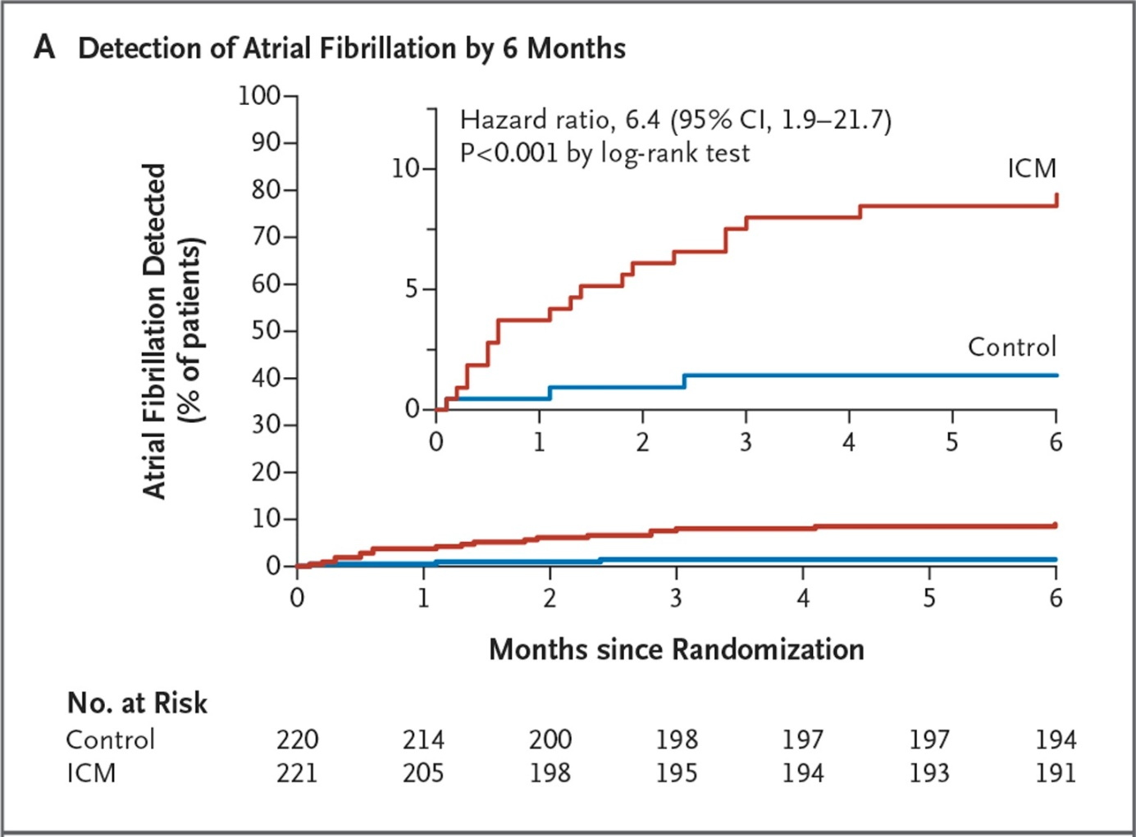
CRYSTAL AF:
Primary End Point Results Detection of Afib by 6 months
Sanna T et al. (2014) N Engl J Med.
Notes:
The primary end point was the time to first detection of atrial fibrillation (lasting >30 seconds) within 6 months. Among the secondary end points was the time to first detection of atrial fibrillation within 12 months.
https://www.nejm.org/doi/full/10.1056/NEJMoa1313600

Slide 29
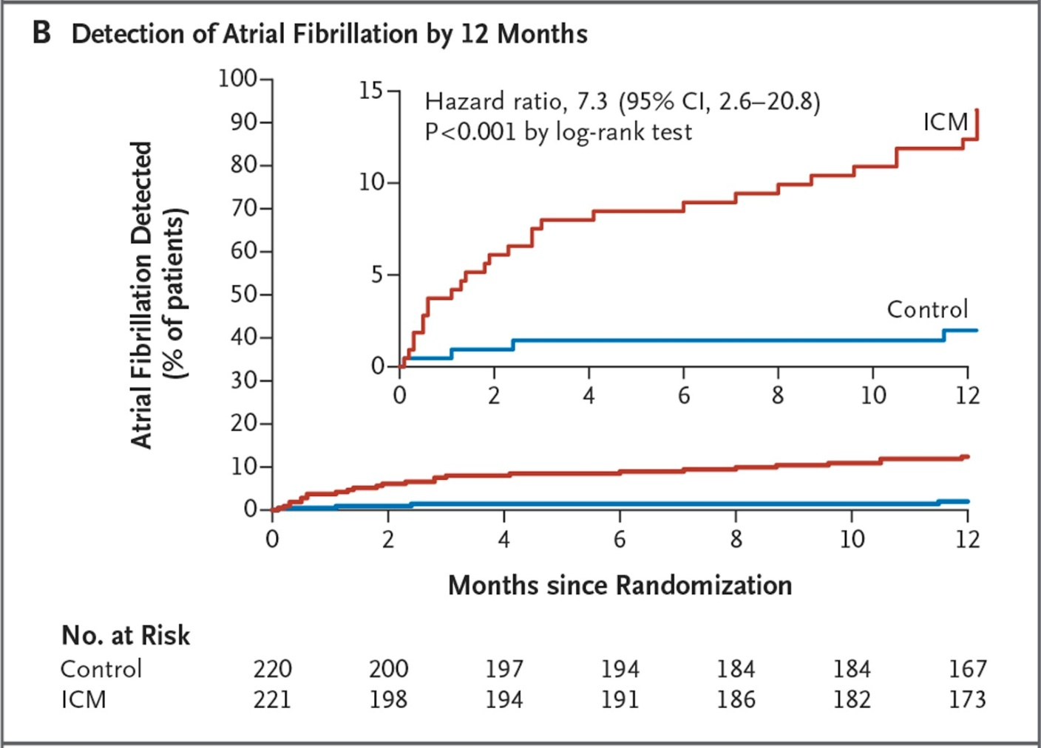
CRYSTAL AF:
Secondary End Point Results Detection of Afib by 12 months
Sanna T et al. (2014) N Engl J Med.
Notes:
The primary end point was the time to first detection of atrial fibrillation (lasting >30 seconds) within 6 months. Among the secondary end points was the time to first detection of atrial fibrillation within 12 months.
https://www.nejm.org/doi/full/10.1056/NEJMoa1313600

Slide 30
EMBRACE Trial
16 stroke centers in Canada
572 patients without known atrial fibrillation and who had CS ischemic stroke or TIA within prior 6 months (cause undetermined after standard tests including 24-hour ECG, to undergo additional non-invasive ambulatory ECG monitoring with either a 30-day event-trigger recorder (intervention group) or a conventional 24-hour monitor (control group).
Age ≥55 (mean age 73)
Comparison of standard (24 hrs) to 30-day event-triggered monitor
Primary outcome: 30 seconds of AF detected by 90 days
Gladstone DJ et al. (2014) N Engl J Med
Notes:
Source: Gladstone DJ, Spring M, Dorian P, et al. Atrial fibrillation in patients with cryptogenic stroke. N Engl J Med. 2014;370:2467-2477.

Slide 31
EMBRACE Trial - Results
 | Control (24 hrs) | 30 Day Monitor | P-value
Primary outcome: AF ≥30 secs | 3.2% | 16.1% | <0.001
Secondary outcome: AF ≥2.5 min | 2.5% | 9.9% | <0.001
Change from antiplatelet to anticoagulant therapy | 4.7% | 13.6% | <0.001
Gladstone DJ et al. (2014) N Engl J Med.
Notes:
Source: Gladstone DJ, Spring M, Dorian P, et al. Atrial fibrillation in patients with cryptogenic stroke. N Engl J Med. 2014;370:2467-2477. https://www.nejm.org/doi/full/10.1056/NEJMoa1311376

Slide 32
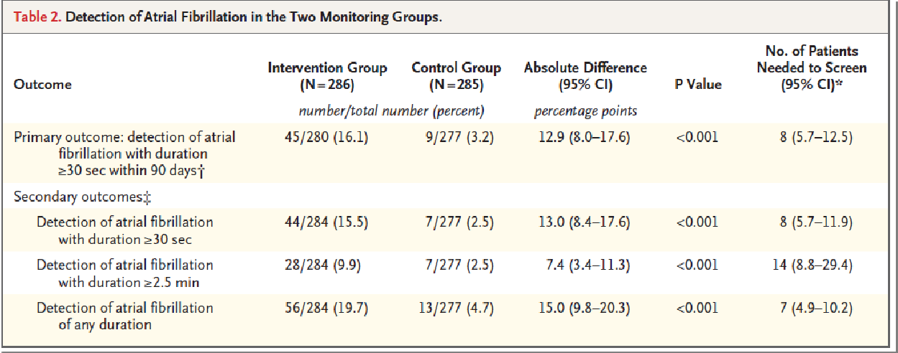
EMBRACE Trial
Detection of AF in EMBRACE
Number needed to screen: 8
Gladstone DJ et al. (2014) N Engl J Med
Notes:
DETECTION OF ATRIAL FIBRILLATION IN THE TWO GROUPS
Table 2.Detection of Atrial Fibrillation in the Two Monitoring Groups.The 30-day ECG monitoring strategy was superior to 24-hour ECG monitoring for the detection of at least one episode of atrial fibrillation lasting 30 seconds or longer (the primary outcome). Atrial fibrillation was detected in 45 of 280 patients (16.1%) in the intervention group, as compared with 9 of 277 (3.2%) in the control group, for an absolute difference of 12.9 percentage points (95% confidence interval [CI], 8.0 to 17.6; P<0.001; number needed to screen, 8) (Table 2).
Source: Gladstone DJ, Spring M, Dorian P, et al. Atrial fibrillation in patients with cryptogenic stroke. N Engl J Med. 2014;370:2467-2477. https://www.nejm.org/doi/full/10.1056/NEJMoa1311376

Slide 33
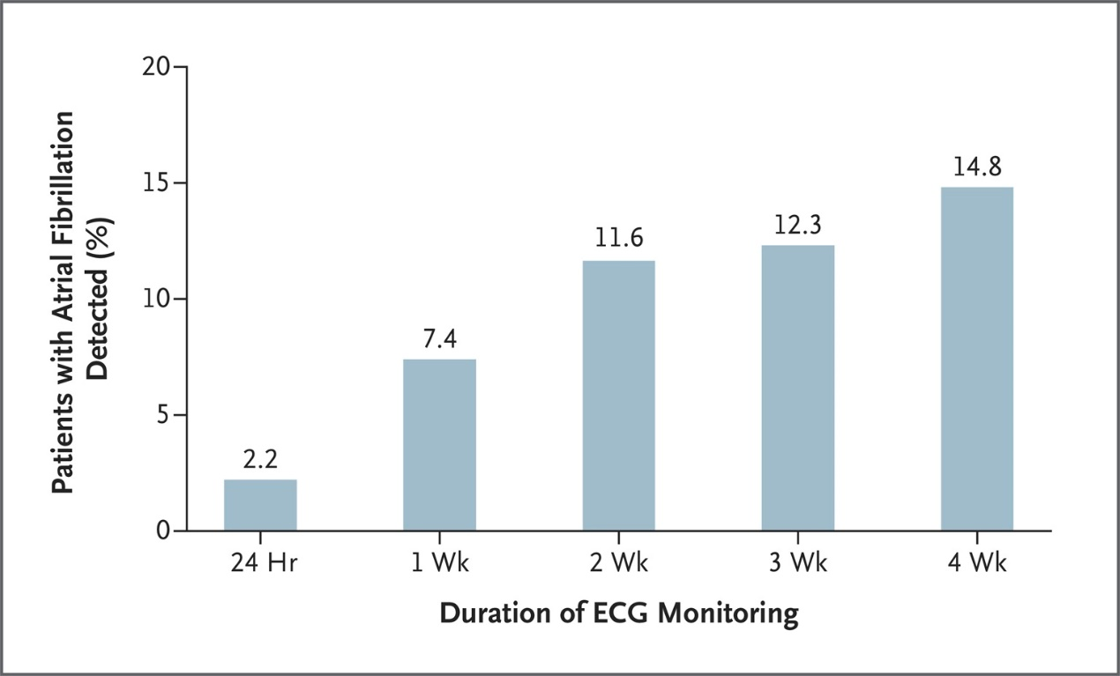
EMBRACE Trial
82% in intervention group completed ≥3 weeks of monitoring
75% of AF captured after first 2 weeks
By 90 days, anticoagulant therapy was prescribed for 18.6% of intervention group, compared to 11.1% of control
Gladstone DJ et al. (2014) N Engl J Med.
Notes:
By 90 days, oral anticoagulant therapy had been prescribed for more patients in the intervention group than in the control group (52 of 280 patients [18.6%] vs. 31 of 279 [11.1%]; absolute difference, 7.5 percentage points; 95% CI, 1.6 to 13.3; P=0.01).
Source: Gladstone DJ, Spring M, Dorian P, et al. Atrial fibrillation in patients with cryptogenic stroke. N Engl J Med. 2014;370:2467-2477. https://www.nejm.org/doi/full/10.1056/NEJMoa1311376

Slide 34
EMBRACE vs CRYSTAL AF: Different Studies, Different Results
CRYSTAL AF¹ :
Inclusion criteria
  Age ≥40 years
  Ischemic stroke or TIA within previous 90 days
  Stroke classified as cryptogenic after extensive workup
Primary end point
  Time to first detection of AF at 6 months follow-up
Definition of AF episode
  AF lasting >30 seconds*
EMBRACE² :
Inclusion criteria
  Age ≥55 years
  Ischemic stroke or TIA within previous 6 months
  Stroke classified as cryptogenic after standard workup**
Primary end point
  Detection of ≥1 episode of ECG documented AF within 90 days
Definition of AF episode
  AF lasting >30 seconds
*For ICM group, episodes must have been >2 minutes to be detected.
Note** the stroke work-up in the two studies were different. In CRYSTAL, TEE was required. EMBRACE did not require TEE.
1. Sanna T et al. N Engl J Med. 2014;370:2478-2486. 2. Gladstone DJ et al. N Engl J Med. 2014;370:2467-2477.
Notes:
Full reference information:
Tommaso Sanna, M.D., Hans-Christoph Diener, M.D., Ph.D., Rod S. Passman, M.D., M.S.C.E., Vincenzo Di Lazzaro, M.D., Richard A. Bernstein, M.D., Ph.D., Carlos A. Morillo, M.D., Marilyn Mollman Rymer, M.D., Vincent Thijs, M.D., Ph.D., Tyson Rogers, M.S., Frank Beckers, Ph.D., Kate Lindborg, Ph.D., and Johannes Brachmann, M.D. for the CRYSTAL AF Investigators*. Cryptogenic Stroke and Underlying Atrial Fibrillation. N Engl J Med 2014; 370:2478-2486; DOI: 10.1056/NEJMoa1313600
David J. Gladstone, M.D., Ph.D., Melanie Spring, M.D., Paul Dorian, M.D., Val Panzov, M.D., Kevin E. Thorpe, M.Math., Judith Hall, M.Sc., Haris Vaid, B.Sc., Martin O'Donnell, M.B., Ph.D., Andreas Laupacis, M.D., Robert Côté, M.D., Mukul Sharma, M.D., John A. Blakely, M.D., et al., for the EMBRACE Investigators and Coordinators*. Atrial Fibrillation in Patients with Cryptogenic Stroke. N Engl J Med 2014; 370:2467-2477; DOI: 10.1056/NEJMoa1311376

Slide 35
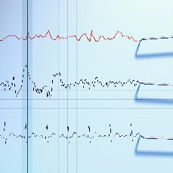
Detection of Occult Paroxysmal Atrial Fibrillation
The 2021 AHA/ASA Guidelines for Prevention of Stroke in Patients with Ischemic Stroke or Transient Ischemic Attack recommend the following for detection of occult AF¹:
In patients suspected of having a stroke or TIA, an ECG is recommended to
screen for atrial fibrillation (AF) and atrial flutter and to assess for other
concomitant cardiac conditions. (Class 1, LOE B-R)
In patients with cryptogenic stroke who do not have a contraindication
to anticoagulation, long-term rhythm monitoring with mobile cardiac
outpatient telemetry, implantable loop recorder, or other approach
is reasonable to detect intermittent AF. (Class 2a, LOE B-R)
The 2019 AHA/ACC/HRS Focused Update of the 2014 AHA/ACC/HRS Guideline for the Management of Patients With Atrial Fibrillation similarly recommends the following²:
In patients with cryptogenic stroke (i.e., stroke of unknown cause) in whom external ambulatory monitoring is inconclusive, implantation of a cardiac monitor (loop recorder) is reasonable to optimize detection of silent AF (Class 2a; LOE B-R).
1. Kleindorfer DO et al. (2021);Stroke. 2, January CT et al. (2019) Circulation.
Notes:
Full reference information:
1. Kleindorfer DO, Towfighi A, Chaturvedi S, et al. 2021 Guideline for the Prevention of Stroke in Patients with Stroke and Transient Ischemic Attack: A Guideline from the American Heart Association/American Stroke Association. Stroke. 2021;52:e364–e467.
2. January CT, Wann LS, Calkins H, Chen LY, Cigarroa JE, Cleveland JC Jr, Ellinor PT, Ezekowitz MD, Field ME, Furie KL, Heidenreich PA, Murray KT, Shea JB, Tracy CM, Yancy CW. 2019 AHA/ACC/HRS focused update of the 2014 AHA/ACC/HRS guideline for the management of patients with atrial fibrillation: a report of the American College of Cardiology/American Heart Association Task Force on Clinical Practice Guidelines and the Heart Rhythm Society. Circulation. 2019;139:e•••–e•••. doi: 10.1161/CIR.0000000000000665

Slide 36
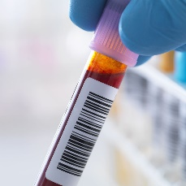
ADDITIONAL WORKUP: Further Laboratory Testing
When a stroke etiology has not been identified during initial evaluation, further laboratory testing may be considered based on patient-specific clinical factors (age, comorbidities) and presentation.
2021 AHA/ASA Guideline Recommendation¹:
In patients with cryptogenic stroke, tests for inherited or acquired hypercoagulable state, bloodstream or cerebral spinal fluid infections, infections that can cause central nervous system (CNS) vasculitis (eg, HIV and syphilis), drug use (eg, cocaine and amphetamines), and markers of systemic inflammation and genetic tests for inherited diseases associated with stroke are reasonable to perform as clinically indicated to identify contributors to or relevant risk factors for stroke. (Class 2a, LOE C-LD)
1. Kleindorfer DO et al. (2021);Stroke.
Notes:
Full reference information:
Kleindorfer DO, Towfighi A, Chaturvedi S, et al. 2021 Guideline for the Prevention of Stroke in Patients with Stroke and Transient Ischemic Attack: A Guideline from the American Heart Association/American Stroke Association. Stroke. 2021;52:e364–e467.

Slide 37
AHA/ASA Treatment Recommendations for potential cryptogenic stroke etiologies

Slide 38
Secondary Stroke Prevention with PFO
MRI of brain confirming ischemic stroke
MRI or CT of intracranial and extracranial vessels with contrast
Contrasted echocardiography or other advanced cardiac imaging
Early evaluation for DVT, including lower extremity doppler and consideration of pelvic MRV
Prolonged cardiac monitoring to screen for intermittent atrial fibrillation
Consider toxicology screen,
C-reactive protein, antiphospholipid antibodies, other labs as indicated
Low threshold for blood cultures, hypercoagulable evaluation, vasculitis workup including catheter angiogram and LP, consideration of rare causes of stroke including genetic etiologies
Patients age 18-60 with non-lacunar stroke and PFO
Evaluation for cause by combined neurology/cardiology team
Alternative
etiology
found?
High Risk PFO – PFO closure is reasonable
Factors reducing potential benefit of closure:
  Low RoPE score, including older age and multiple risk factors
  Need for anticoagulation
(Class 2a)
YES
NO
Treat underlying etiology
Potential paradoxical embolism
YES
Atrial
septal aneurysm
or large
right-to-left
shunt
Low Risk PFO – Benefit of PFO closure is not well established
Factors increasing potential benefit of closure:
  High RoPE score, including young age and no risk factors
  History of DVT or prothrombotic condition
  Prior non-lacunar stroke or cortical TIA
  Failure of antiplatelet treatment
  (Class 2b)
Abbreviations: CT indicates computed tomography; DVT, deep vein thrombosis; LP, lumbar puncture; MRI, magnetic resonance imaging; MRV, magnetic resonance venography; PFO, patent foramen ovale; rope, risk of paradoxical embolism; and TIA, transient ischemic attack.
NO
Kleindorfer DO et al. (2021);Stroke
Notes:
Kleindorfer DO, Towfighi A, Chaturvedi S, et al. 2021 Guideline for the Prevention of Stroke in Patients with Stroke and Transient Ischemic Attack: A Guideline from the American Heart Association/American Stroke Association. Stroke. 2021;52:e364–e467.

Slide 39
PFO guideline recommendations
The 2021 AHA/ASA Guideline for Prevention of Stroke in Patients with Stroke or Transient Ischemic Attack recommend the following:
In patients with a nonlacunar ischemic stroke of undetermined cause and a PFO, recommendations for PFO closure versus medical management should be made jointly by the patient, a cardiologist, and a neurologist, taking into account the probability of a causal role for the PFO. (Class I, Level of Evidence C-EO).
In patients 18 to 60 years of age with a nonlacunar ischemic stroke of undetermined cause despite a thorough evaluation and a PFO with high-risk anatomic features, it is reasonable to choose closure with a transcatheter device and long-term antiplatelet therapy over antiplatelet therapy alone for preventing recurrent stroke. (Class IIa, Level of Evidence B-R)
In patients 18 to 60 years of age with a nonlacunar ischemic stroke of undetermined cause despite a thorough evaluation and a PFO without high-risk anatomic features, the benefit of closure with a transcatheter device and long-term antiplatelet therapy over antiplatelet therapy alone for preventing recurrent stroke is not well established, (Class IIb, Level of Evidence C-LD)
In patients 18 to 60 years of age with a nonlacunar ischemic stroke of undetermined cause
despite a thorough evaluation and a PFO, the comparative benefit of closure with a
transcatheter device versus warfarin is unknown. (Class IIb, Level of Evidence C-LD)
Kleindorfer DO et al. (2021);Stroke
Notes:
Source: Kleindorfer DO, Towfighi A, Chaturvedi S, et al. 2021 Guideline for the Prevention of Stroke in Patients with Stroke and Transient Ischemic Attack: A Guideline from the American Heart Association/American Stroke Association. Stroke. 2021;52:e364–e467.

Slide 40
Occult Paroxysmal AF
The 2021 AHA/ASA Guideline for Prevention of Stroke in Patients with Stroke or Transient Ischemic Attack¹ recommends the following:
In patients with cryptogenic stroke who do not have a contraindication to anticoagulation, long-term rhythm monitoring with mobile cardiac outpatient telemetry, implantable loop recorder, or other approach is reasonable to detect intermittent AF. (Class IIa, Level of Evidence B-R)
In patients with nonvalvular AF and stroke or TIA, oral anticoagulation (eg, apixaban, dabigatran, edoxaban, rivaroxaban, or warfarin) is recommended to reduce the risk of recurrent stroke. (Class I, Level of Evidence A)
In patients with AF and stroke or TIA, oral anticoagulation is indicated to reduce the risk of recurrent stroke regardless of whether the AF pattern is paroxysmal, persistent, or permanent. (Class I, Level of Evidence B-R)
In patients with stroke or TIA and AF who do not have moderate to severe mitral stenosis or a mechanical heart valve, apixaban, dabigatran, edoxaban, or rivaroxaban is recommended in preference to warfarin to reduce the risk of recurrent stroke. (Class I, Level of Evidence B-R)
In patients with atrial flutter and stroke or TIA, anticoagulant therapy similar to that in AF is indicated to reduce the risk of recurrent stroke. (Class I, Level of Evidence B-NR)
Kleindorfer DO et al. (2021);Stroke
Notes:
Source: Kleindorfer DO, Towfighi A, Chaturvedi S, et al. 2021 Guideline for the Prevention of Stroke in Patients with Stroke and Transient Ischemic Attack: A Guideline from the American Heart Association/American Stroke Association. Stroke. 2021;52:e364–e467.

Slide 41
Occult Paroxysmal AF, continued
The 2021 AHA/ASA Guideline for Prevention of Stroke in Patients with Stroke or Transient Ischemic Attack¹ recommends the following:
In patients with AF and stroke or TIA, without moderate to severe mitral stenosis or a mechanical heart valve, who are unable to maintain a therapeutic INR level with warfarin, use of dabigatran, rivaroxaban, apixaban, or edoxaban is recommended to reduce the risk of recurrent stroke. (Class I, Level of Evidence C-EO)
In patients with stroke at high risk of hemorrhagic conversion in the setting of AF, it is reasonable to delay initiation of oral anticoagulation beyond 14 days to reduce the risk of ICH. (Class IIa, Level of Evidence B-NR)
In patients with stroke at low risk for hemorrhagic conversion in the setting of AF, it may be reasonable to initiate anticoagulation 2 to 14 days after the index event to reduce the risk of recurrent stroke. (Class IIb, Level of Evidence B-NR)
In patients with TIA in the setting of nonvalvular AF, it is reasonable to initiate anticoagulation immediately after the index event to reduce the risk of recurrent stroke. (Class IIa, Level of Evidence C-EO)
Kleindorfer DO et al. (2021);Stroke
Notes:
Source: Kleindorfer DO, Towfighi A, Chaturvedi S, et al. 2021 Guideline for the Prevention of Stroke in Patients with Stroke and Transient Ischemic Attack: A Guideline from the American Heart Association/American Stroke Association. Stroke. 2021;52:e364–e467.

Slide 42
Occult Paroxysmal AF, continued
The 2021 AHA/ASA Guideline for Prevention of Stroke in Patients with Stroke or Transient Ischemic Attack¹ recommends the following:
In patients with stroke or TIA in the setting of nonvalvular AF who have contraindications for lifelong anticoagulation but can tolerate at least 45 days, it may be reasonable to consider percutaneous closure of the left atrial appendage with the Watchman device to reduce the chance of recurrent stroke and bleeding. (Class IIb, Level of Evidence B-R)
In patients with AF and stroke or TIA who have end-stage renal disease or are on dialysis, it may be reasonable to use warfarin or apixaban (dose adjusted if indicated) for anticoagulation to reduce the chance of recurrent stroke. (Class IIb, Level of Evidence B-NR)
Kleindorfer DO et al. (2021);Stroke
Notes:
Source: Kleindorfer DO, Towfighi A, Chaturvedi S, et al. 2021 Guideline for the Prevention of Stroke in Patients with Stroke and Transient Ischemic Attack: A Guideline from the American Heart Association/American Stroke Association. Stroke. 2021;52:e364–e467.

Slide 43
Hypercoagulable states
The 2021 AHA/ASA Guideline for Prevention of Stroke in Patients with Stroke or Transient Ischemic Attack recommend the following:
In patients with cryptogenic stroke, tests for inherited or acquired hypercoagulable state, bloodstream or cerebral spinal fluid infections, infections that can cause central nervous system (CNS) vasculitis (eg, HIV and syphilis), drug use (eg, cocaine and amphetamines), and markers of systemic inflammation and genetic tests for inherited diseases associated with stroke are reasonable to perform as clinically indicated to identify contributors to or relevant risk factors for stroke. (Class IIa, Level of Evidence C-LD).
In patients with ischemic stroke or TIA of unknown source despite thorough diagnostic evaluation and no other thrombotic history who are found to have prothrombin 20210A mutation, activated protein C resistance, elevated factor VIII levels, or deficiencies of protein C, protein S, or antithrombin III, antiplatelet therapy is reasonable to reduce the risk of recurrent stroke or TIA. (Class IIa, Level of Evidence C-LD)
In patients who have an isolated antiphospholipid antibody but do not fulfill the criteria for antiphospholipid syndrome, antiplatelet therapy alone is recommended to reduce the risk of recurrent stroke. (Class I, Level of Evidence B-NR)
Kleindorfer DO et al. (2021);Stroke
Notes:
Source: Kleindorfer DO, Towfighi A, Chaturvedi S, et al. 2021 Guideline for the Prevention of Stroke in Patients with Stroke and Transient Ischemic Attack: A Guideline from the American Heart Association/American Stroke Association. Stroke. 2021;52:e364–e467.

Slide 44
Hypercoagulable states, continued
The 2021 AHA/ASA Guideline for Prevention of Stroke in Patients with Stroke or Transient Ischemic Attack recommend the following:
In patients with confirmed antiphospholipid syndrome treated with warfarin, it is reasonable to choose a target INR between 2 and 3 over a target INR >3 to effectively balance the risk of excessive bleeding against the risk of thrombosis. (Class IIa, Level of Evidence B-R)
In patients who meet the criteria for the antiphospholipid syndrome, it is reasonable to anticoagulate with warfarin to reduce the risk of recurrent stroke or TIA. (Class IIa, Level of Evidence C-LD)
In patients with ischemic stroke or TIA, antiphospholipid syndrome with history of thrombosis and triple-positive antiphospholipid antibodies (ie, lupus anticoagulant, anticardiolipin, and anti– β2 glycoprotein-I), rivaroxaban is not recommended because it is associated with excess thrombotic events compared with warfarin. (Class III, Level of Evidence B-R)
Kleindorfer DO et al. (2021);Stroke
Notes:
Source: Kleindorfer DO, Towfighi A, Chaturvedi S, et al. 2021 Guideline for the Prevention of Stroke in Patients with Stroke and Transient Ischemic Attack: A Guideline from the American Heart Association/American Stroke Association. Stroke. 2021;52:e364–e467.

Slide 45
Aortic Arch Atheroma
The 2021 AHA/ASA Guideline for Prevention of Stroke in Patients with Stroke or Transient Ischemic Attack recommend the following:
In patients with a stroke or TIA and evidence of an aortic arch atheroma, intensive lipid management to an LDL cholesterol target <70 mg/dL is recommended to prevent recurrent stroke. (Class I, Level of Evidence B-R)
In patients with a stroke or TIA and evidence of an aortic arch atheroma, antiplatelet therapy is recommended to prevent recurrent stroke. (Class I, Level of Evidence C-LD)
Kleindorfer DO et al. (2021);Stroke
Notes:
Source: Kleindorfer DO, Towfighi A, Chaturvedi S, et al. 2021 Guideline for the Prevention of Stroke in Patients with Stroke and Transient Ischemic Attack: A Guideline from the American Heart Association/American Stroke Association. Stroke. 2021;52:e364–e467.

Slide 46
dissection
The 2021 AHA/ASA Guideline for Prevention of Stroke in Patients with Stroke or Transient Ischemic Attack recommend the following:
Treatment with antithrombotic therapy for at least 3 months is indicated to prevent recurrent stroke or TIA. (Class I, Level of Evidence C-EO)
In patients who are <3 months after an extracranial carotid or vertebral arterial dissection, it is reasonable to use either aspirin or warfarin to prevent recurrent stroke or TIA. (Class IIa, Level of Evidence B-R)
In patients with stroke or TIA and extracranial carotid or vertebral artery dissection who have recurrent events despite antithrombotic therapy, endovascular therapy may be considered to prevent recurrent stroke or TIA. (Class IIb, Level of Evidence C-LD)
Kleindorfer DO et al. (2021);Stroke
Notes:
Source: Kleindorfer DO, Towfighi A, Chaturvedi S, et al. 2021 Guideline for the Prevention of Stroke in Patients with Stroke and Transient Ischemic Attack: A Guideline from the American Heart Association/American Stroke Association. Stroke. 2021;52:e364–e467.

Slide 47
Cardiac Tumors, Malignancy, & Stroke
Abbreviation: DOAC indicates direct acting oral anticoagulants.
Stroke or Transient Ischemic Attack
AND
AND
Left-sided cardiac tumor
Atrial fibrillation
AND
Cancer
Tumor resection
(Class 2a)
DOAC preferred over warfarin (Class 2a)
Kleindorfer DO et al. (2021);Stroke
Notes:
Kleindorfer DO, Towfighi A, Chaturvedi S, et al. 2021 Guideline for the Prevention of Stroke in Patients with Stroke and Transient Ischemic Attack: A Guideline from the American Heart Association/American Stroke Association. Stroke. 2021;52:e364–e467.
In patients with stroke or TIA found to have a left-sided cardiac tumor, resection of the tumor can be beneficial to reduce the risk of recurrent stroke. (Class IIa, Level of Evidence C-LD)
In patients with ischemic stroke or TIA in the setting of AF and cancer, it is reasonable to consider anticoagulation with direct-acting oral anticoagulants in preference to warfarin for stroke prevention. (Class IIa, Level of Evidence B-NR)

Slide 48
vasculitis
The 2021 AHA/ASA Guideline for Prevention of Stroke in Patients with Stroke or Transient Ischemic Attack recommend the following:
In patients with ischemic stroke or TIA and symptoms attributed to giant cell arteritis, immediate initiation of oral high-dose glucocorticoids is recommended to reduce recurrent stroke risk. (Class I, Level of Evidence B-NR)
In patients with ischemic stroke or TIA and infectious vasculitis such as varicella zoster virus (VZV) cerebral vasculitis, neurosyphilis, or bacterial meningitis, treating the underlying infectious etiology is indicated to reduce the risk of stroke. (Class I, Level of Evidence B-NR)
Kleindorfer DO et al. (2021);Stroke
Notes:
Source: Kleindorfer DO, Towfighi A, Chaturvedi S, et al. 2021 Guideline for the Prevention of Stroke in Patients with Stroke and Transient Ischemic Attack: A Guideline from the American Heart Association/American Stroke Association. Stroke. 2021;52:e364–e467.

Slide 49
Management of Cryptogenic Stroke
Specific recommendations regarding prevention strategies often depend on the ischemic stroke subtype.
Management of vascular risk factors remains extremely important in secondary stroke prevention.
Antithrombotic therapy, including antiplatelet or anticoagulant agents, is recommended for nearly all patients who do not have contraindications.
  But with very few exceptions, the combination of antiplatelets and anticoagulation is typically not indicated.
  Identifying the potential etiology of the stroke and previously unknown risk factors is therefore important for determining the most appropriate antithrombotic medication.
Kleindorfer DO et al. (2021);Stroke
Notes:
Source: Kleindorfer DO, Towfighi A, Chaturvedi S, et al. 2021 Guideline for the Prevention of Stroke in Patients with Stroke and Transient Ischemic Attack: A Guideline from the American Heart Association/American Stroke Association. Stroke. 2021;52:e364–e467.

Slide 50
Management of Cryptogenic Stroke, continued
The mainstay of stroke prevention strategies in patients with cryptogenic stroke is the combination of antiplatelet therapy and stroke risk factor modification.¹
In patients with non-cardioembolic ischemic stroke or TIA, antiplatelet therapy is recommended in preference to oral anticoagulation to reduce the risk of recurrent stroke while minimizing bleeding risk (Class I, Level of Evidence A).²
The Warfarin-Aspirin Recurrent Stroke Study (WARSS) found no difference in the primary end point of 2-year recurrent ischemic stroke or death between the warfarin and aspirin groups, while anticoagulation is associated with a significantly increased risk of bleeding.³
1. Zhang C et al. (2016). 2. Kleindorfer DO et al. (2021);Stroke. 3. Mohr JP et al. (2001);N Engl J Med.
Notes:
Sources:
Zhang C, Kasner S. Diagnosis, prognosis, and management of cryptogenic stroke. F1000Res. 2016 Feb 12;5.
Kleindorfer DO, Towfighi A, Chaturvedi S, et al. 2021 Guideline for the Prevention of Stroke in Patients with Stroke and Transient Ischemic Attack: A Guideline from the American Heart Association/American Stroke Association. Stroke. 2021;52:e364–e467.
Mohr JP, Thompson JL, Lazar RM, et al. Warfarin-Aspirin Recurrent Stroke Study Group. A comparison of warfarin and aspirin for the prevention of recurrent ischemic stroke. N Engl J Med. 2001;345:1444–1451.

Slide 51
Management of Cryptogenic Stroke, continued
Knowing the ischemic stroke subtype is important for tailoring prevention recommendations for patients with embolic strokes.
Patients with ESUS should not be treated with direct-acting oral anticoagulants or ticagrelor because they were found to be of no benefit in two clinical trials, NAVIGATE ESUS and RESPECT ESUS.^{1,2}
Ongoing trials may help address some of the persistent questions about optimal treatment for secondary stroke prevention in patients with ESUS.
Meanwhile, thorough evaluation to attempt to uncover the source of the embolism may be the best strategy for guiding decision-making related to which antithrombotic medication to prescribe.
1. Hart RG et al. (2018);N Engl J Med. 2. Diener HC et al. (2019);N Engl J Med.
Notes:
Sources:
1. Hart RG, Sharma M, Mundl H, et al; NAVIGATE ESUS Investigators. Rivaroxaban for stroke prevention after embolic stroke of undetermined source. N Engl J Med. 2018;378:2191–2201.
2. Diener HC, Sacco RL, Easton JD, et al; RE-SPECT ESUS Steering Committee and Investigators. Dabigatran for prevention of stroke after embolic stroke of undetermined source. N Engl J Med. 2019;380:1906–1917.

Slide 52
Case Studies

Slide 53
Case Study: Occult Paroxysmal AF
Patient Info:
51-year-old woman
Episode of unsteady gait and dizziness (<1 hour)
On admission:
  BP 140/86
  HR 68 BPM
  No neurologic deficits
After urgent MRI, admitted to intensive care unit for further assessment
Case study courtesy of John Rogers, MD.

Slide 54
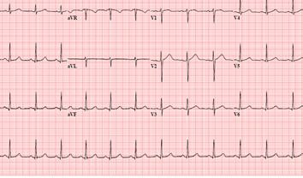
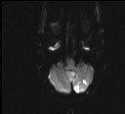
Case Study: Occult Paroxysmal AF
Evaluation:
Two areas of infarct were identified in the left cerebellum.
MRA of head and neck and chest x-ray returned normal results.
TTE showed normal LV size and function.
Subsequent TEE confirmed these results. Also showed that her atrial size was at the upper limits of normal.
TEE showed that there was no thrombus and there were normal velocities in the LAA, a normal aortic arch, and no evidence of a patent foramen ovale.
24-hour telemetry monitoring was negative for arrhythmia.
Results of
in-hospital ECG
Case study courtesy of John Rogers, MD.

Slide 55
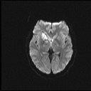
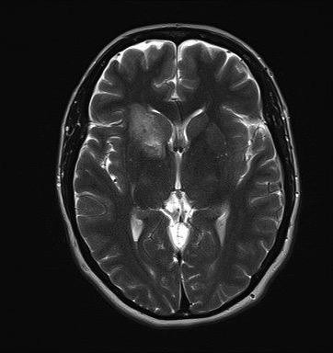
Case Study: Occult Paroxysmal AF
Patient discharged on an antiplatelet and was followed for an additional 14 days with mobile cardiac telemetry
No arrhythmias identified during this period
Five weeks after her initial stroke presentation, she developed a recurrence of unsteadiness and dizziness.
Patient also developed a right-sided headache with nausea and vomiting.
Symptoms lasted 2 hours.
Patient was admitted to the ICU after an urgent brain MRI.
Case study courtesy of John Rogers, MD.

Slide 56
Case Study: Occult Paroxysmal AF
The patient underwent extensive additional evaluation, including a workup for hypercoagulability, which was negative.
She was subsequently implanted with an ICM and discharged on antiplatelet therapy.
After 2 months of monitoring, episodes of paroxysmal AF lasting 15 to 90 minutes were detected.
  Episodes were asymptomatic despite mean ventricular rates in >120 BPM.
The patient was changed from prior antiplatelet regimen to an oral anticoagulant.
Case study courtesy of John Rogers, MD.

Slide 57
Case Study: Left posterior cerebral artery infarction and PFO
Patient info:
A 51-year-old right-handed attorney:
  Previously healthy
  Exercised regularly
  Took no medications
He returned from a family ski vacation, driving several hours without stopping.
After returning home, he suddenly felt:
  Light-headed
  Right hand and leg then became weak
  Had difficulty speaking
  Severe headache
  Loss of vision to the right
His wife called 911 and they went to the local hospital emergency room.
Case study courtesy of Mitchell S. V. Elkind, MD, MS, FAAN, FAHA

Slide 58
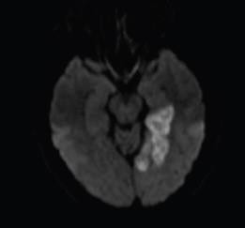
Case Study: Left posterior cerebral artery infarction and PFO
Results
Head CT was negative.
He received intravenous alteplase (tPA).
The brain MRI on the day after following admission
showed a left medial occipital and temporal infarction.
Transesophageal echocardiography showed a small PFO but was otherwise unremarkable.
There was no evidence of deep venous thrombosis, and the remainder of his evaluation was unremarkable for a source of stroke.
He recovered well and was able to return to work without difficulty.
Case study courtesy of Mitchell S. V. Elkind, MD, MS, FAAN, FAHA

Slide 59
conclusions

Slide 60
Conclusions
Cryptogenic stroke is a diagnosis of exclusion.
This category of stroke can be expected to decrease in size over time as implementation of recommendations for a thorough diagnostic workup becomes more widespread.
Secondary prevention strategies should be tailored to the ischemic stroke subtype.
It is clear from long-term monitoring studies of patients with cryptogenic stroke that between one-fifth and one-third of these patients have paroxysmal AF and are at risk for cardioembolic stroke, regardless of etiology of first stroke.
Management of vascular risk factors remains extremely important in secondary stroke prevention of cryptogenic stroke patients, including (but not limited to) diabetes, smoking cessation, lipids and especially hypertension.
  Aggressive medical management, often performed by multidisciplinary
  teams, is usually best, with goals of therapy tailored to the individual patient.

Slide 61
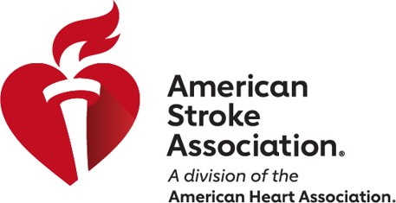

For more tools and resources for health professionals and patients: stroke.org/cryptogenic
Medtronic supports the American Stroke Association’s Cryptogenic Stroke Initiative.

Slide 62
references

Slide 63
references
Adams HP Jr, Bendixen BH, Kappelle LJ, et al. Classification of subtype of acute ischemic stroke. Definitions for use in a multicenter clinical trial. TOAST. Trial of Org 10172 in Acute Stroke Treatment. Stroke. 1993 Jan;24(1):35-41. doi: 10.1161/01.STR.24.1.35
Amarenco P, Bogousslavsky J, Caplan LR, et al. The ASCOD phenotyping of ischemic stroke (Updated ASCO Phenotyping). Cerebrovasc Dis. 2013;36(1):1-5. doi: 10.1159/000352050
Arsava EM, Ballabio E, Benner T, et al. The Causative Classification of Stroke system: an international reliability and optimization study [published correction appears in Neurology. 2011 Jan 11;76(2):202]. Neurology. 2010;75(14):1277–1284. doi:10.1212/WNL.0b013e3181f612ce
Bang OY, Ovbiagele B, Kim JS. Evaluation of Cryptogenic Stroke With Advanced Diagnostic Techniques. Stroke. 2014;45:1186-1194. doi: 10.1161/STROKEAHA.113.003720
Chinitz JS, Vaishnava P, Narayan RL, Fuster V. Atrial Fibrillation Through the Years: Contemporary Evaluation and Management. Circulation. 2013;127:408-416. doi: 10.1161/CIRCULATIONAHA.112.120758
Dardiotis E, Aloizou AM, Markoula S, et al. Cancer-associated stroke: pathophysiology, detection and management (review). Int J Oncol. 2019;54:779–796.
Diener HC, Sacco RL, Easton JD, et al; RE-SPECT ESUS Steering Committee and Investigators. Dabigatran for prevention of stroke after embolic stroke of undetermined source. N Engl J Med. 2019;380:1906–1917.
Feng W, Hendry RM, Adams RJ. Risk of recurrent stroke, myocardial infarction, or death in hospitalized stroke patients. Neurology. 2010;74(7):588-93. doi: 10.1212/WNL.0b013e3181cff776
Fonkem E, Dayawansa S, Stroberg E, Lok E, Bricker PC, Kirmani B, Wong ET, Huang JH. Neurological presentations of intravascular lymphoma (IVL): meta-analysis of 654 patients. BMC Neurol. 2016;16:9.
Gladstone DJ, Spring M, Dorian P, et al. Atrial fibrillation in patients with cryptogenic stroke. N Engl J Med. 2014;370:2467-2477. doi: 10.1056/NEJMoa1311376
Hart RG, Pearce LA, Aguilar MI. Meta-analysis: antithrombotic therapy to prevent stroke in patients who have nonvalvular atrial fibrillation. Ann Intern Med. 2007 Jun 19;146(12):857-67.
Hart RG, Diener HC, Coutts SB, et al. Cryptogenic Stroke/ESUS International Working Group. Embolic strokes of undetermined source: the case for a new clinical construct. Lancet Neurol. 2014 Apr;13(4):429-38.
Hart RG, Sharma M, Mundl H, et al; NAVIGATE ESUS Investigators. Rivaroxaban for stroke prevention after embolic stroke of undetermined source. N Engl J Med. 2018;378:2191–2201.
January CT, Wann LS, Calkins H, et al. 2019 AHA/ACC/HRS focused update of the 2014 AHA/ACC/HRS guideline for the management of patients with atrial fibrillation: a report of the American College of Cardiology/ American Heart Association Task Force on Clinical Practice Guidelines and the Heart Rhythm Society. Circulation. 2019;139. doi: 10.1016/j.jacc.2019.01.011

Slide 64
references
Jauch EC, Saver JL, Adams HP Jr, et al.; on behalf of the American Heart Association Stroke Council, Council on Cardiovascular Nursing, Council on Peripheral Vascular Disease, and Council on Clinical Cardiology. Guidelines for the early management of patients with acute ischemic stroke: a guideline for healthcare professionals from the American Heart Association/American Stroke Association. Stroke. 2013;44:870–947. doi: 10.1161/STR.0b013e318284056a
Kernan WN, Ovbiagele B, Black HR, et al.; on behalf of the American Heart Association Stroke Council, Council on Cardiovascular and Stroke Nursing, Council on Clinical Cardiology, and Council on Peripheral Vascular Disease. Guidelines for the prevention of stroke in patients with stroke and transient ischemic attack: a guideline for healthcare professionals from the American Heart Association/American Stroke Association. Stroke. 2014;45:2160–2236.
Kleindorfer DO, Towfighi A, Chaturvedi S, et al. 2021 Guideline for the Prevention of Stroke in Patients with Stroke and Transient Ischemic Attack: A Guideline from the American Heart Association/American Stroke Association. Stroke. 2021;52:e364–e467.
Kronzon I, Tunick PA. Aortic Atherosclerotic Disease and Stroke. Circulation. 2006;114:63-75. doi: 10.1161/CIRCULATIONAHA.105.593418
Lai MM, Li TC, Lin CL, et al. Benign neoplasm of the heart increases the risk of first ischemic stroke: a population-based cohort study. Int J Stroke. 2015;10:202–206.
Lin HJ1, Wolf PA, Kelly-Hayes M. Stroke severity in atrial fibrillation. The Framingham Study. Stroke. 1996;27(10):1760-4.
Manning WJ. Echocardiography in detection of cardiac and aortic sources of systemic embolism. http://www.uptodate.com/contents/echocardiography-in-detection-of-cardiac-and-aortic-sources-of-systemic-embolism. Accessed May 9, 2019.
Mohr JP, Thompson JL, Lazar RM, et al. Warfarin-Aspirin Recurrent Stroke Study Group. A comparison of warfarin and aspirin for the prevention of recurrent ischemic stroke. N Engl J Med. 2001;345:1444–1451.
Najem B, Lefrancq E, Unger P. Thrombus Trapped in Patent Foramen Ovale and Bilateral Pulmonary Embolism; A One-Stop Shop Ultrasound Diagnosis. Circulation. 2008;118:e154-e155. doi: 10.1161/CIRCULATIONAHA.108.777433
Redekop GJ. Extracranial carotid and vertebral artery dissection: a review. Can J Neurol Sci. 2008;35:146–152.
Reynen K. Frequency of primary tumors of the heart. Am J Cardiol. 1996;77:107.
Sanna T, Diener HC, Passman RS et al.; for the CRYSTAL AF Investigators*. Cryptogenic Stroke and Underlying Atrial Fibrillation. N Engl J Med. 2014; 370:2478-2486; doi: 10.1056/NEJMoa1313600
Saver JL. Cryptogenic Stroke. N Engl J Med. 2016;374:2065-74. doi: 10.1056/NEJMcp1503946
Søndergaard L, Kasner SE, Rhodes JF, et al. Patent Foramen Ovale Closure or Antiplatelet Therapy for Cryptogenic Stroke. N Engl J Med. 2017;377:1033-1042. doi: 10.1056/NEJMoa1707404

Slide 65
references
Varona JF, Guerra JM, Bermejo F, Molina JA, Gomez de la Cámara A. Causes of ischemic stroke in young adults, and evolution of the etiological diagnosis over the long term. Eur Neurol. 2007;57:212–218.
Virani SS, Alonso A, Aparacio HJ, et al, On behalf of the American Heart Association Council on Epidemiology and Prevention Statistics Committee and Stroke Statistics Subcommittee. Heart disease and stroke statistics-2021 update: a report from the American Heart Association. Circulation. 2021;143:e00–e00.
Winstein CJ, Stein J, Arena R, et al.; on behalf of the American Heart Association Stroke Council, Council on Cardiovascular and Stroke Nursing, Council on Clinical Cardiology, and Council on Quality of Care and Outcomes Research. Guidelines for adult stroke rehabilitation and recovery: a guideline for healthcare professionals from the American Heart Association/American Stroke Association. Stroke. 2016;47:e98–e169. doi: 10.1161/STR.0000000000000098
Wolf PA, Abbott RD, Kannel WB. Atrial fibrillation: a major contributor to stroke in the elderly. The Framingham Study. Arch Intern Med. 1987;147(9):1561-4.
Yaghi S, Bernstein RA, Passman R, Okin PM, Furie KL. Cryptogenic Stroke: Research and Practice. Circulation Research. 2017;120(3):527-540. https://doi.org/10.1161/CIRCRESAHA.116.308447
Yaghi S, Elkind MS. Cryptogenic stroke: A diagnostic challenge. Neurol Clin Pract. 2014;4(5):386–393.
Zhang C, Kasner S. Diagnosis, prognosis, and management of cryptogenic stroke. F1000Res. 2016 Feb 12;5.

Slide 66
Thank you

